Slide 1
Citation Classics Adult Reconstruction: Periprosthetic Joint Infections

Slide 2
The 2018 Definition of Periprosthetic Hip and Knee Infection: An Evidence-Based and Validated Criteria Javad Parvizi, MD, Timothy L. Tan, MD, Karan Goswami, MD, Carlos Higuera, MD, Craig Della Valle, MD, Antonia F. Chen, MD, MBA, Noam Shohat, MD Journal of Arthroplasty 2018

Slide 3
Background Diagnosing PJI is difficult and there’s no “one-stop-shop” test Previous MSIS endorsed consensus definition (2013) → sinus tract, 2 positive cultures, or 3/5 criteria – serum inflammatory markers, synovial cell count, PMNs, positive histology, and single culture positive Purpose: 1. Generate weight-adjusted scoring system for defining PJIs 2. Externally validate 3. Compare the new scoring system vs the previous
Notes:
Importance: There is no 100% certain test to dx PJI which commonly presents ambiguously and has devastating consequences

Slide 4
Methods Retrospective review of all revision TKA and THA cases from 3 centers (2001-2016) Exclusions: no serum labs, no aspiration, acute PJIs, did not meet MSIS major criteria
Notes:
2001-2016
Diagnostic markers
-C-reactive protein, D-dimer, erythrocyte sedimentation rate
-Synovial white blood cell count, polymorphonuclear percentage, leukocyte esterase, alpha-defensin, synovial CRP
-Frozen section, presence of purulence intraoperative, isolation of pathogen by culture
- ICM cutoffs used
Statistical analysis
Estimate each marker influence on PJI diagnosis
Learning dataset – 684 infeciton 820 aseptic, 2001-16
Missing data- imputation (extrapolate or estiamte its values from other values)
Stepwise approach to include the pretest probability of PJI
Pt have different levels of suspicion required before test is ordered which can influence analysis
Step 1 - serum markers CRP, D-dimer, ESR
Low P stop, else Step 2
Step 2 - synovial WBC, PMN%, CRP, LE, Alpha-defensin
Low or high P stop, else Step 3
Step 3 - histology, purulence, +culture
ROC curve analysis - sense and spec v value
AUC >,7 acceptable
Each step
Random forest analysis
output relative weight and importance of each marker = ranking prediction power of each marker
Multivariate logistic regression
Markers that predicted similarly were grouped into criterion
Markers given integer value based on how well predicts PJI
Preop dx score w weighted stage 1+2 makrers
Intraop dx score w weighted stage 3 markers for pt w ambigious preop dx score and stage 3 markers
Sample dataset – 222 aseptic 200 infeciton
Dx cut points set
Validated False+ , false -, true+,true-,sens,spec
Compared to previous MSIS And ICM system

Slide 5
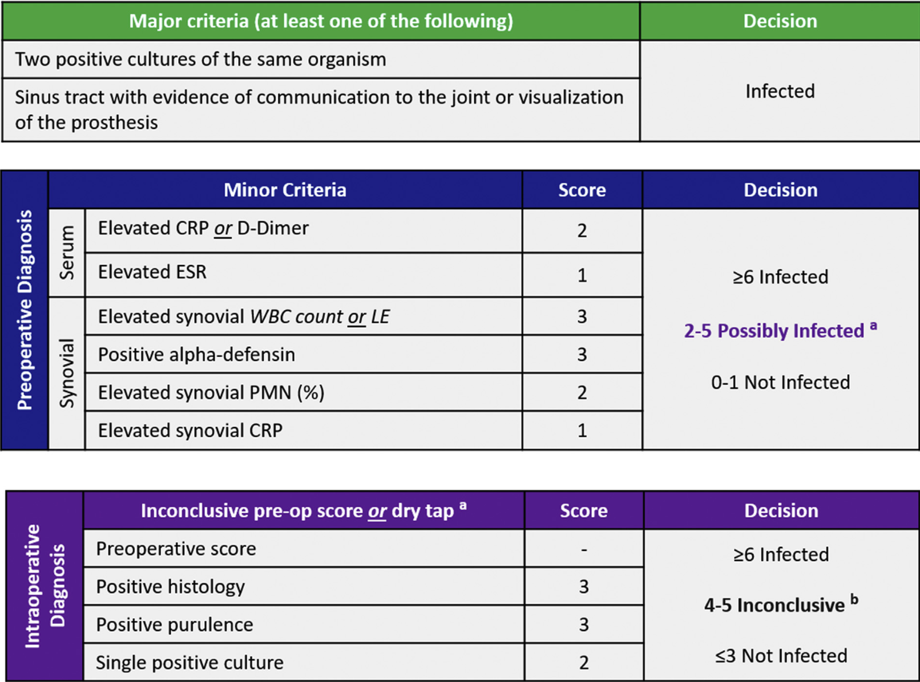
Results Sensitivity 97.7 Specificity 99.5
Notes:
Previous criteria did not consider chronicity or invasiveness – for example, 3/6 minor criteria initially are typicaly intraoperative findings so preoperatively not very useful
Discussion of inclusive diagnosis was also additionally made here which previously we did not have; this is more like what we may face in clinical practice –”

Slide 6
Conclusions First externally validated, evidence-based criteria for diagnosing PJI after TJA More useful during the preoperative phase of diagnosis “Gray area” Utility of next-generation sequencing Limitations Implementation in acute PJIs Tool for diagnosis vs guide for testing Combined hips and knees
Notes:
Separate scores for pre-op and intra-op markers
2011 MSIS coimbined making, preox dx difficult
Used imputation in learning dataset
Imputation- estimating missing values from adjacent data
Did not use in validation dataset
Used ICM threshold values for each test
Couldve found value for each marker that best predicts to improve system
Combined hips and knees Sens and spec remained high for hips and knees seperately

Slide 7
Two-Stage Exchange Protocol for Periprosthetic Joint Infection Following Total Knee Arthroplasty in 245 Knees without Prior Treatment for Infection Stephen M. Petis, MD, FRCSC, Kevin I. Perry, MD, Tad M. Mabry, MD, Arlen D. Hanssen, MD, Daniel J. Berry, MD, and Matthew P. Abdel, MD The Journal of Bone and Joint Surgery 2019

Slide 8
Background PJI is a devastating outcome following TKA 2-stage exchange has been considered gold-standard treatment Prior survival rates 80-95% (however confounded) Purpose: To determine long-term reinfection rates for TKAs complicated by PJI without previous infection treatment
Notes:
Prior studies
Euro studies
https://pubmed.ncbi.nlm.nih.gov/19234888/
https://pubmed.ncbi.nlm.nih.gov/16643519/
https://pubmed.ncbi.nlm.nih.gov/16835763/
https://pubmed.ncbi.nlm.nih.gov/17966006/
https://pubmed.ncbi.nlm.nih.gov/18704413/
https://pubmed.ncbi.nlm.nih.gov/21596440/
Goldman 1996
Insall
64 knee pji tka 2stage
FU 7.5yr 2-17yr
More strict selection criteria
No abx loaed bone cement
9 % reinfected
https://journals.lww.com/clinorthop/fulltext/1996/10000/2_stage_reimplantation_for_infected_total_knee.16.aspx
Mayo 2004
96 knees sp 2 stage exchange forTKA PJI
Abx spacer and cement
7.2 yr fu (2.5-13.2)
Reinfevtion, aseptic faiiure
16% reop - 9% inf, 6% aseptic
https://journals.lww.com/clinorthop/fulltext/2004/11000/the_chitranjan_ranawat_award__mid_term_to.5.aspx
First american study on pt naïve to PJI tx; also included risk factors for failure; included analysis of effect of previous knee revision sx

Slide 9
Methods Retrospective review, single institution, TKAs treated with 2-stage revision (1991-2006) → 630 cases → exclusions → 245 cases Diagnosis of PJI via Musculoskeletal Infection Society criteria Surgical Technique: --Implant removal, I&D, antibiotic spacer --6 weeks of IV antibiotics --5 weeks of antibiotic holiday --Re-implantation Follow-up 3 months, 1 year, 2 years, 5 years, and every 5 years - Mean FU 14 yr (2-25) - Calculate Incidence of reinfection - Calculate Incidence of aseptic revision - Evaluate Risk factors for reinfection and aseptic loosening
Notes:
- 1991-2006 - No prior tx for PJI - 73% Major or 4/6 minor criteria - Mean age at spacer insertion 68yr - 50% F
Prior PJI tx: examples
debridement, abx, and implaint retention/modular exchange
Resection arthroplasty
Failed 2 stage revision
Abx
Referred w spacer
Risk factors evaluated with Cox proportional hazards regression -> output hazard ratios KSS calculated

Slide 10
Results Reinfection: 4.1% at 1 years 9.5% at 2 years 14.2% at 5 years 16.4% at 10 years 16.9% at 15 years Last follow-up – 41 knees re-infected Risk factors predictive of reinfection: BMI ≥30 Previous revision surgery McPherson host grade of C KSS improved from 45 at PJI diagnosis to 76 at 10 years
Notes:
Factors predictive of reinfection
body mass index > 30 kg/m2
(hazard ratio [HR], 3.1; p < 0.01)
previous revision surgery
(HR, 2.8; p < 0.01)
McPherson host grade of C
(HR, 2.5; p = 0.04)
2+ compromising factors
Absolute neutrophil count <1000
CD4 count < 100
IV drug use
Chronic infection in other site
Immune dyspalsia or neoplasm
Femoral (HR, 5.0; p = 0.04) and tibial (HR, 6.7; p < 0.01) bone-grafting at reimplantation were predictive of aseptic failure

Slide 11
Conclusions 15 year cumulative incidence of reinfection after PJI treatment with 2-stage protocol was 17% Obesity, history of revision surgery, and poor host were predictors Strengths – Well defined cohort with 15 years of cumulative follow-up Limitations – Retrospective (standardization), single institution (generalizability)
Notes:
Not including risk of death can overestimate risk factors

Slide 12
Two-stage Exchange Arthroplasty for Infected Total Knee Arthroplasty: Predictors of Failure S. M. Javad Mortazavi MD, David Vegari MD, Anthony Ho BA, Benjamin Zmistowski BS, Javad Parvizi MD, FRCS Clinical Orthopedics and Related Research, 2011

Slide 13
Background Two stage exchange is the gold-standard treatment for PJIs Literature cites variable effectiveness as 67-91% eradication of infection after treatment Variability may be affected by different factors – patient and surgeon factors Purpose: Determine rate of PJI eradiaction after 2-stage exchange Assess variables that may influence outcomes after 2-stage exchange
Notes:
Important to determine the right time for reimplantation – which factors to look out for that predict failure, manage those for success
Similar study from Parvizi in 2010 more ocused on MRSA effect on failure and risk factors for MRSA
That study exluded patients treateed for PJI At another instituion – unclear about tx at same institution or abx

Slide 14
Methods Retrospective review, single institution database, patients who underwent 2-stage exchange from 1997-2007 → 117 patients 2-stage exchange protocol: 1. Resection, debridement, antibiotic-spacer 2. IV antibiotics 3. Antibiotic holiday and clinical assessment 4. Reimplanation Rate of recurrence or failure of treatment of PJI = needing further treatment for PJI Assessed factors that may predict recurrent or failure of treatment
Notes:
- 1997-2007
Min FU 2yr
15 preop and 11 op factors
Compare success and fail
T test
Chi square
Multivariate logistic regression
Recursive partitioning
Extractds decision trees

Slide 15
Results 28% required subsequent treatment for recurrent infection Predictors of failure (UVA) 1. Intraop purulence/sinus tract during 1st stage (p=0.02) 2. Positive tissue culture (p=0.02) Predictors of failure (MVA) 1. Negative culture [OR 4.5, p=0.02] 2. Methicillin-resistant organisms cultured [OR, 2.8, p=0.12] 3. Increased operative time at reimplantation [OR, 1.01, p=0.05]

Slide 16
Conclusions A combination of factors should be assessed before re-implantation Non-predictors interestingly included ESR and CRP interstage point of revision *Important to think about it before re-implantation Comorbidities that previously may have presumably increased rate of failure – i.e. DM, obesity, CAD – did not associate with treatment failure Limitations Single tertiary referral center lends itself to selection bias Retrospective → missing data Limited sample size → may not have identified all significant variables Multiple surgeons with variable protocols
Notes:
Tertiary center- more likely t have sicker pts w multiple revisions w worse otucomes
Prior study – Parvizi 2010
https://www.ncbi.nlm.nih.gov/pmc/articles/PMC2895842/
Before, ESR and CRP were mainly used as indicators of pt readiness for eimplantation – this study proved wrong

Slide 17
Swab Cultures Are Not As Effective As Tissue Cultures for Diagnosis of Periprosthetic Joint Infection
Aggarwal et al, (Rothman group) CORR 2013​
Prospective cohort study comparing effectiveness of swab cultures vs. tissue samples in diagnosing PJIs

Slide 18
Background
Cx negative PJI remains an issue and makes abx tx more challening
No consensus on the best way to obtain samples
Swab Cultures Benefits: easy and cost effective
Swab Culture Issues: contamination, decreased volume
Notes:
- Musculoskeletal Infection Society (MSIS) definition of periprosthetic infection (PJI) includes at least 3/5 criteria of:
1.) Sinus tract communicating with prosthesis
2.) Pathogen isolated by culture from at least 2 separate tissue or fluid samples from affected prosthetic joint
3.) Four of the following six criteria exist:
- 1.) Elevated ESR and serum CRP concentration
- 2.) Elevated synovial leukocyte count
- 3.) Elevated synovial neutrophil percentage (PMN%)
- 4.) Presence of purulence in the affected joint
- 5.) Isolation of microorganism in one culture of periprosthetic tissue or fluid
- 6.) Greater than five neutrophils per high power field in five high-power fields observed from histologic analysis of periprosthetic tissue at x400 magnification
- No consensus from the American Academy of Orthopaedic Surgeons (AAOS) about best method to obtaining specimens to detect infecting pathogens.
- Tissue sampling, swab cultures, fluid aspiration, implant sonication as examples.

Slide 19
Methods
Prospective study, 117 revision arthroplasties from 2011-2012.
74 total hip and 43 total knee revisions.
30 septic, 87 aseptic revisions.
Modified MSIS criteria (pre-2019) were used to dx PJI
3 tissue and 3 swab samples collected.
Results of cultures: Sensitivity, Specificity, PPV, NPV
Notes:
- Collected tissue and swab samples from 156 revision arthroplasty procedures from 2011-2012.
- 39 exclusions (revision procedure where there is reimplantation or incorrect and/or inadequate specimen collection due to human error.
- Reimplantation (cannot truly diagnose pts as aseptic or septic).
- Final Analysis: 117 procedures, 74 total hip revision, 43 total knee revision, 87 aseptic and 30 septic.
- Mean age: 62 (range, 27-87), 53 men, 64 women.
- PJI criteria used
- 1.) Sinus tract communicating with the prosthesis OR
- 2.) Pathogen was isolated by culture from 2 separate fluid samples from affected prosthetic joint OR
- 3.) At least 3 of the five following criteria (Elevated ESR 30 mm/hour and CRP 1.0 mg/dL, Elevated synovial WBC 10,700 cells/uL for acute and 3,000 cells/uL for chronic, Elevated synovial PMN at 89% for acute and 80% for chronic, presence of purulence at joint, isolation of microorganism)
- The Histologic analysis was removed because frozen section histology in revision arthroplasty is not commonly done.
- Acute post-op PJI is 6 weeks after surgery while chronic is after 6 weeks.
- Operations performed by one of five fellowship-trained joint reconstruction surgeons.
- Aseptic: removal or exchange of any prosthetic components due to loosening of components, instability of joint, polyethylene wear, joint subluxation, arthrofibrosis, periprosthetic fracture.
- Three tissue and three swab samples collected from same location after arthrotomy.
- 1.) Hip: Acetabular bone, synovial joint capsule, and femoral bone
- 2.) Knee: Femoral bone, synovial joint capsule, and tibial bone.

Slide 20
Results
More false positives and false negatives in culture swabs
Sensitivity, specificity, PPV, NPV higher for tissue culture
Positive tissue culture associated with true diagnosis of PJI compared to swab
Most common pathogens grown
Notes:
- Septic Cases: Tissues in 28/30 (93%) produced a positive culture while swabs in 21/30 (70%) produced a positive culture.
- Aseptic Cases: Tissue was positive in 2/87 (2%) of cases while swabs was positive in 10/87 (12%) of cases.
- Odds ratio of 57 for tissue sample and OR of 5 for swabs for diagnosis of PJI.
- Pathogens: Staph aureus, coagulase negative staphylococcal species, streptococcal species (including enterococcus), gram negative organism, polymicrobial, then culture negative.

Slide 21
Conclusion
Periprosthetic tissue cultures are better at identifying microorganisms compared to swab cultures
Limitations:
Cultured for 5 days, possible inflation of false negatives, truly aseptic, no consensus definition of PJI
Future: Cost effectiveness and efficiency of diagnostic methods
Notes:
- Identifying infecting microorganisms is paramount in diagnosing PJIs.
- Periprosthetic tissue cultures demonstrated superior microorganism identification compared to swab cultures taken from the same sites.
- Recommendation: Do not use swab cultures for diagnosing PJIs.
- Future Efforts: Increasing sensitivity and specificity of results, cost effectiveness, efficiency of diagnostic methods to enable widespread use among orthopaedic and infectious disease community.
- Limitations:
- Septic cases with no initial growth were cultured for 14 more days and aseptic cases were always less than 2 weeks.
- Possible that aseptic could be septic.
- Histologic frozen section of MSIS criteria removed.

Slide 22
Increased risk of PJI following primary TKA/THA with the use of alternative antibiotics to cefazolin
Wyles et al (Mayo), JBJS 2019
Retrospective cohort of 29.6k TJAs done at single institution

Slide 23
Background
Cefazolin/cephlosporin prophylaxis for TKA and THA.
Minimal side effects, excellent coverage for organisms seen in PJIs
Vancomycin or clindamycin are alternatives in case of allergy or MRSA (vancomycin)
Cross reactivity between penicillin and cephalosporin in small, but higher than non-penicillin reactors
Retrospective Cohort:
Characterize abx choices for perioperative prophylaxis of primary THA/TKA
Assess efficacy of preoperative antibiotic allergy testing
Determine rates of PJI based on periop antibiotic
Notes:
- First generation cephalosporins, 1 g to 3 g of cefazolin 60 within 60 minutes of surgical incision for prophylaxis on total knee arthroplasty and total hip arthroplasty.
- Cephalosporins has low side effect profile, excellent coverage for organisms found in prosthetic joint infections.
- Challenge: Pts that are allergic to penicillin atbx, colonized preop by MRSA (use vanco)
- Use vanco or clindamycin is contraindicated.
- TKA and THA pts receiving atbx other than cefazolin had 50% increase in surgical site infections more frequently.
- Cefazolin substitutions are recommended for beta lactams due to penicillin allergy but pts continued to have higher risk of infection from MRSA and Clostridium difficile.
- American Academy of Allergy, Asthma, and Immunology wants pts with uncertain or historically documented penicillin allergies to undergo formal testing to confirm presence or absence, and severity of allergy.
- Which atbxs are used for perioperative prophylaxis of TKA and THAs.
- Efficacy of preoperative allergy testing programme.
- Rates of PJI based on perioperative antibiotic regimen.

Slide 24
Methods
Retrospective review of 29.6k THA/TKA (22.7k patients) between 2004-2017
Allergy Testing Registry data was available for 2.5k pts (11.5%)
Database data were combined to evaluate allergy consultation outcomes, perioperative antibiosis, and infection free survivorship
PJI was documented as a complication by third-party reviewers if pt diagnosed with PJI by physician or has a documented positive culture from intraoperative or aspirated synovial fluid specimen
MRSA colonization was determined based on preoperative nasal swab culture results
Notes:
- Pts who had a TKA or THA between 2004-2017.
- 29,695 arthroplasties (from 22,705 pts), with 17,026 TKAs and 12,669 THAs.
- Mean age of 67.1
- Allergy Testing Registry (Total Joint and Allergy Testing Registries).
- PJI
- 1.) The patient has been assigned a diagnosis of PJI by a physician
- 2.) The patient has a documented positive culture from an intraoperative or synovial fluid specimen.
- MRSA colonization assessed by querying and documenting preoperative nasal culture results for the entire cohort.

Slide 25
Results
28,174 (94.9%) of arthroplasties received Cefazolin, 1,521 (5.1%) received non-cefazolin abx (primarily vanc or cinda)
Positive MRSA colonization was more frequent in TJA receiving non-cefazolin abx
Infection free survivorship was higher in the cefazolin group vs non-cefazolin group at all time points out to 10 years
Increased rate of PJI observed in non-cefazolin group was not attributable to high MRSA colonization prevalence as none of the 38 PJI grew MRSA on culture
Allergy consultation increased proportion of patients receiving Cefazolin by 27%.
Notes:
- PJI free in Cefazolin group better after 1 month, 2 month, one year, ten years.

Slide 26
Conclusion
Lower rates of PJIs when Cefazolin was used for surgical prophylaxis in primary TKA and THAs
Preoperative allergy testing increased Cefazolin usage to over 80% of patients tested
Authors recommend perioperative testing and clearance for all patient presenting with penicillin and cephalosporin allergies in effort to positively influence a modifiable risk factor for PJI (abx choice)
Strengths: Large sample size, single institution with individual patient level data
Limitations: Retrospective Cohort Study
Unknown causative organism/susceptibilities in PJIs, unknown timing of administration of antibiotics, applying this data for other institutions who may be using other first-generation cephalosporin ppx

