Slide 1
Citation Classics
Proximal Humerus Fractures
John P Scanaliato, MD
Alexis B Sandler, BA

Slide 2
The Articles
Boileau et al. (2002) – Tuberosity malposition and migration: Reasons for poor outcomes after hemiarthroplasty for displaced fractures of the proximal humerus
Hertel et al. (2004) – Predictors of humeral head ischemia after intracapsular fracture of the proximal humerus
Gardner et al. (2007) – The importance of medial support in locked plating of proximal humerus fractures
Bufquin et al. (2007) – Reverse shoulder arthroplasty for the treatment of three- and four-part fractures of the proximal humerus in the elderly
Südkamp et al. (2009) – Open reduction and internal fixation of proximal humeral fractures with use of the locking proximal humerus plate

Slide 3
Tuberosity malposition and migration: Reasons for poor outcomes after hemiarthroplasty for displaced fractures of the proximal humerus Prospective, Multicenter Observational Study, JSES, 2002, Boileau et al.
BACKGROUND
Although common, hemiarthroplasty (HA) yields unpredictable results in the treatment of displaced proximal humerus fractures
In 1970, Neer et al. described excellent or satisfactory outcomes in 90% of patients treated with HA for proximal humerus fractures, yet no other studies have replicated these results
PURPOSE: assess outcomes after HA for displaced proximal humeral fractures and to identify the clinical and radiologic parameters associated with disappointing results
Notes:
Scanaliato

Slide 4
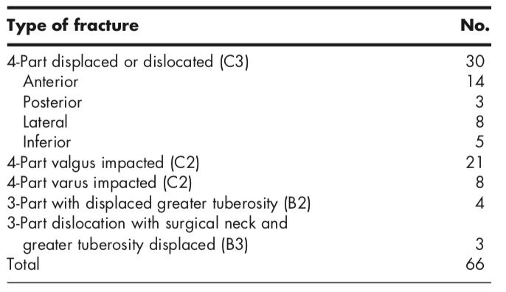
Tuberosity malposition and migration: Reasons for poor outcomes after hemiarthroplasty for displaced fractures of the proximal humerus Prospective, Multicenter Observational Study, JSES, 2002, Boileau et al.
METHODS
Consecutive series of 66 patients
Inclusion criteria: acute 3-part and 4-part displaced proximal humerus fractures that underwent HA with the same nonconstrained shoulder prosthesis
Unsuccessful attempt at reduction before definitive procedure (n = 3)
Osteosynthesis attempted preceding or during arthroplasty (n = 2)
Mean follow up: 27 months (18 – 59 weeks)

Slide 5
Tuberosity malposition and migration: Reasons for poor outcomes after hemiarthroplasty for displaced fractures of the proximal humerus Prospective, Multicenter Observational Study, JSES, 2002, Boileau et al.
METHODS – Surgical Technique
Deltopectoral approach
Aequalis nonconstrained implant, cemented in all patients
Variants
Longitudinal supraspinatus tear (n = 4): side-to-side suture repair
Glenoid fractures at the articular surface (n = 5): inconsequential
Metaphyseal-diaphyseal extension (n = 9): cerclage sutures in 8 cases, cerclage wire in 1
Diaphyseal extension (n = 2): extra long stem
Tuberosity osteosynthesis: heavy nonabsorbable suture and cancellous bone graft from humeral head
Biceps tenodesis (n = 26, 43%)
Notes:
A glenoid fracture at the anteroinferior border of the articular surface was present in 5 cases; all were small enough to be ignored without compromising glenohumeral joint stability

Slide 6
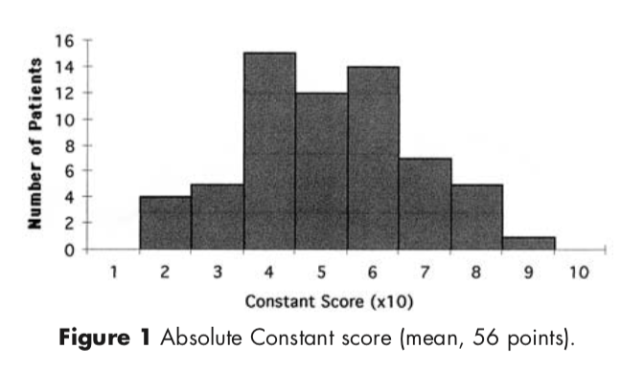
Tuberosity malposition and migration: Reasons for poor outcomes after hemiarthroplasty for displaced fractures of the proximal humerus Prospective, Multicenter Observational Study, JSES, 2002, Boileau et al.
RESULTS – Clinical
Excellent (n = 15)
Good (n = 16)
Fair (n = 22)
Poor (n = 13)

Slide 7
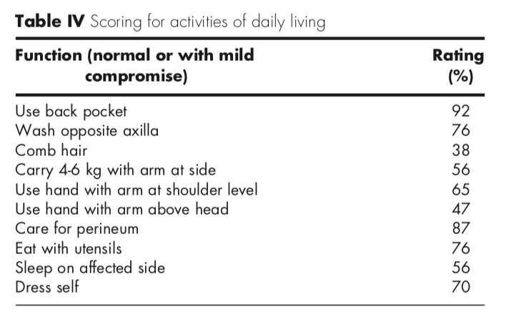
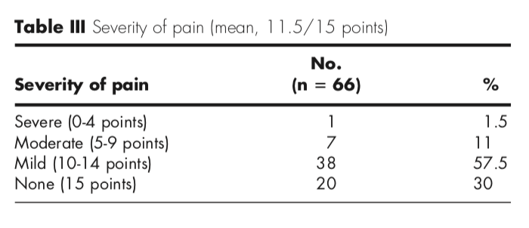
Tuberosity malposition and migration: Reasons for poor outcomes after hemiarthroplasty for displaced fractures of the proximal humerus Prospective, Multicenter Observational Study, JSES, 2002, Boileau et al.
RESULTS – Clinical
Mean scores
Mobility 22.1/40
Activity 12.5/20
Muscular strength 8.5/25
58% satisfied or very satisfied (n = 38)

Slide 8
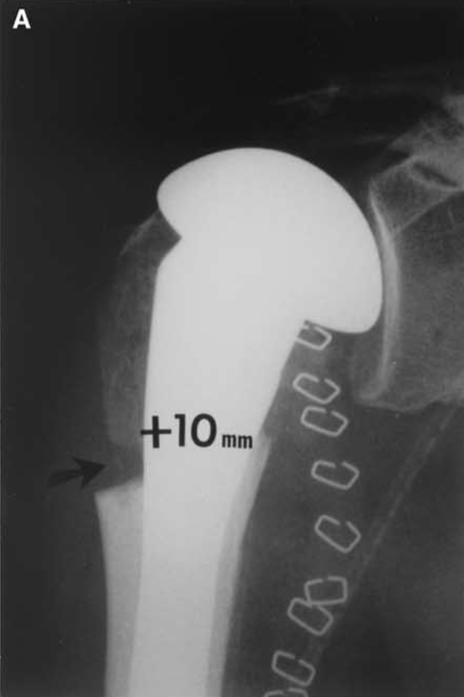
Tuberosity malposition and migration: Reasons for poor outcomes after hemiarthroplasty for displaced fractures of the proximal humerus Prospective, Multicenter Observational Study, JSES, 2002, Boileau et al.
RESULTS – Radiographic Measurements
Initial and final tuberosity malposition
INITIAL: normal if GT 5 – 10 mm below superior aspect of prosthetic head
Vertical: n = 12 (18%) – low in 8, high in 4
Horizontal: n = 15 (23%) – GT too posterior in 12, LT too medial in 3
Total: n = 18 (27%)
Final: normal if GT visible in neutral or external rotation on last AP radiograph
Initial tuberosity malposition

Slide 9
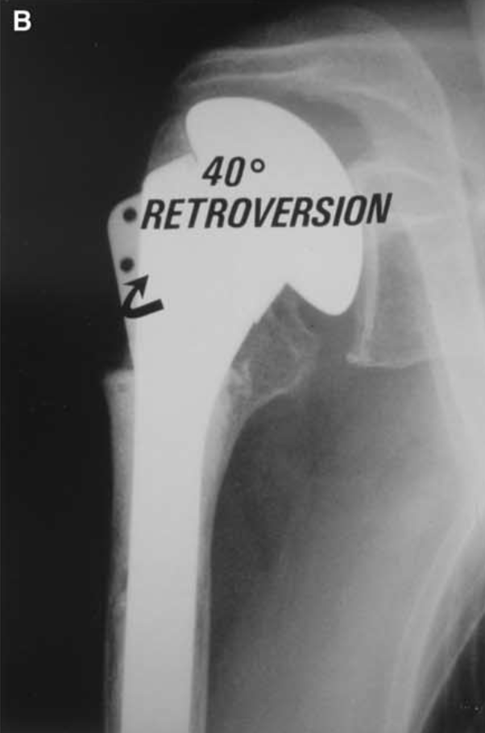
Tuberosity malposition and migration: Reasons for poor outcomes after hemiarthroplasty for displaced fractures of the proximal humerus Prospective, Multicenter Observational Study, JSES, 2002, Boileau et al.
RESULTS – Radiographic Measurements
Initial and final tuberosity malposition
Initial: normal if GT 5 – 10 mm below superior aspect of prosthetic head
FINAL: normal if GT visible in neutral or external rotation on last AP radiograph
Vertical: n = 20 (30%) – low in 9, high in 11
Horizontal: n = 19 (28%)
Total: n = 33 (50%)
Final tuberosity malposition
Notes:
AP view in external rotation at review shows that the greater tuberosity is hidden behind the neck prosthesis with proximal humeral migration

Slide 10
Tuberosity malposition and migration: Reasons for poor outcomes after hemiarthroplasty for displaced fractures of the proximal humerus Prospective, Multicenter Observational Study, JSES, 2002, Boileau et al.
RESULTS – Radiographic Measurements
Initial and final tuberosity malposition
Tuberosity detachment and migration
N = 15 (23%), observed after initial correct and in malposition
Reabsorption in 3 (4%)
Notes:
Figure 4 D, Posterior glenoid impingement due to greater tuberosity (G.T.) displacement and malunion is visible on axillary view. E, Poor abduction.

Slide 11
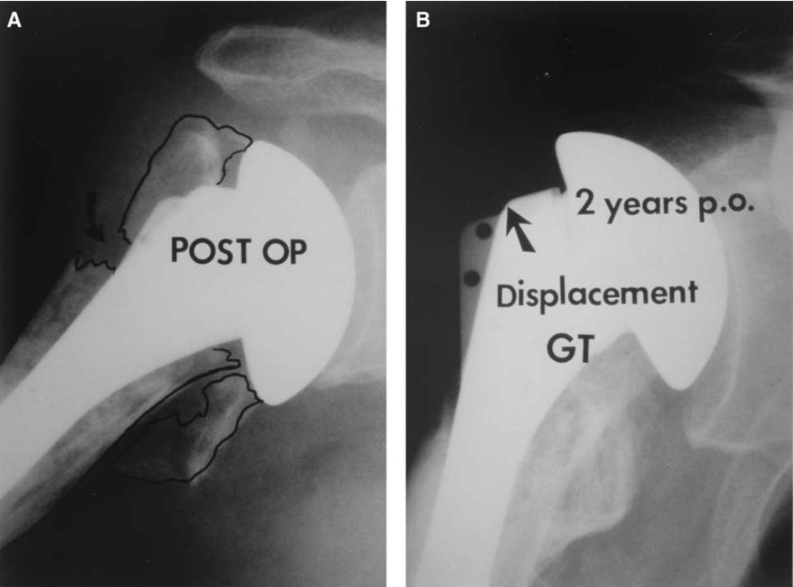
Tuberosity malposition and migration: Reasons for poor outcomes after hemiarthroplasty for displaced fractures of the proximal humerus Prospective, Multicenter Observational Study, JSES, 2002, Boileau et al.
RESULTS – Radiographic Measurements
Initial and final tuberosity malposition
Tuberosity detachment and migration
Prosthetic height/humeral length: normal if difference of <10 mm compared to contralateral
Proud in 10/39 (26%)
Low in 14/36 (36%)
Notes:
A, Proud prosthesis and poor positioning of lesser tuberosity. B, Two years postoperatively (p.o.), the greater tuberosity (GT) is not visible on the AP view and there is a proximal migration of the prosthesis.

Slide 12
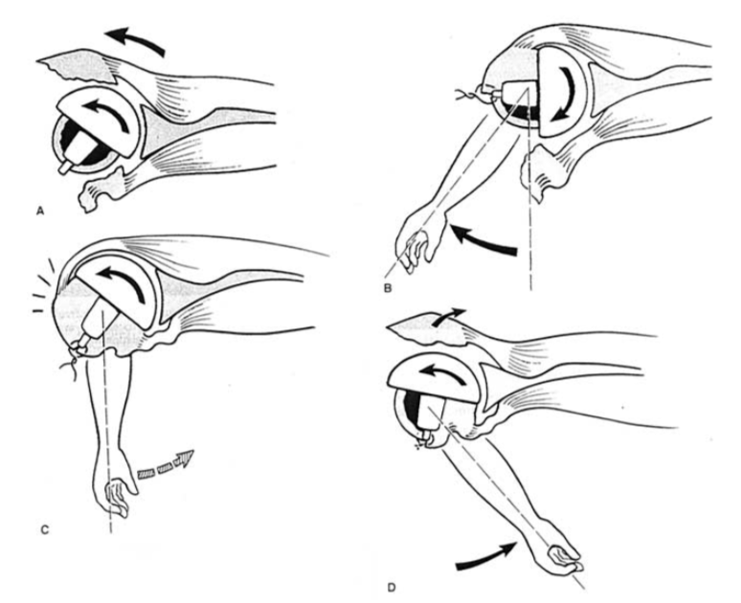
Tuberosity malposition and migration: Reasons for poor outcomes after hemiarthroplasty for displaced fractures of the proximal humerus Prospective, Multicenter Observational Study, JSES, 2002, Boileau et al.
RESULTS – Radiographic Measurements
Initial and final tuberosity malposition
Tuberosity detachment and migration
Prosthetic height/humeral length
Prosthetic retroversion: normal if 0 – 40 deg compared to transepicondylar line
Greater than 40 degrees in 9 (39%)
No anteversion
Notes:
Figure 5 Consequences of an excessive prosthetic retroversion in fractures. A,The prosthesis is cemented with an excessive retroversion. B, Osteosynthesis is possible with the arm in external rotation C, but leads to pull-out the sutures when the arm is in neutral rotation D, and posterior migration of the greater tuberosity when the arm is placed in internal rotation (arm in a sling at the end of the procedure).

Slide 13
Tuberosity malposition and migration: Reasons for poor outcomes after hemiarthroplasty for displaced fractures of the proximal humerus Prospective, Multicenter Observational Study, JSES, 2002, Boileau et al.
RESULTS – Radiographic Measurements
Initial and final tuberosity malposition
Tuberosity detachment and migration
Prosthetic height/humeral length
Prosthetic retroversion
Proximal migration: normal if acromiohumeral distance < 7mm
N = 15 (22%)

Slide 14
Tuberosity malposition and migration: Reasons for poor outcomes after hemiarthroplasty for displaced fractures of the proximal humerus Prospective, Multicenter Observational Study, JSES, 2002, Boileau et al.
RESULTS – Radiographic Measurements
Initial and final tuberosity malposition
Tuberosity detachment and migration
Prosthetic height/humeral length
Prosthetic retroversion
Proximal migration
Periarticular ectopic bone formation
N = 7 (10.5%)
True scapulohumeral bridge in 2
No correlation with functional results

Slide 15
Tuberosity malposition and migration: Reasons for poor outcomes after hemiarthroplasty for displaced fractures of the proximal humerus Prospective, Multicenter Observational Study, JSES, 2002, Boileau et al.
RESULTS – Radiographic Measurements
Initial and final tuberosity malposition
Tuberosity detachment and migration
Prosthetic height/humeral length
Prosthetic retroversion
Proximal migration
Periarticular ectopic bone formation
Radiolucent lines around prosthetic stem: loosening of prosthesis
Complete line > 1 mm: N = 4 (6%)
Incomplete line < 1 mm: N = 16 (24%)
No radiographic loosening with a complete line over 2 mm

Slide 16
Tuberosity malposition and migration: Reasons for poor outcomes after hemiarthroplasty for displaced fractures of the proximal humerus Prospective, Multicenter Observational Study, JSES, 2002, Boileau et al.
RESULTS – Correlations
Final tuberosity malposition: high, low, or posterior GT → poor functional outcomes
Prosthesis malposition
Height: shortening of >15 mm → decreased Constant scores, <10 mm acceptable
Retroversion: over 40 degrees → poor functional outcomes
Malposition of prosthesis → tuberosity malposition
“Unhappy triad” = high prosthesis + retroverted prosthesis + low GT
Present in 5 cases, associated with migration of GT and prosthesis in all cases → persistent pain and stiffness
Age and sex: women over 75 → GT migration and poor outcomes

Slide 17
Tuberosity malposition and migration: Reasons for poor outcomes after hemiarthroplasty for displaced fractures of the proximal humerus Prospective, Multicenter Observational Study, JSES, 2002, Boileau et al.
RESULTS – Complications
Neurological (n = 3): all transient and involving axillary nerve
Anterior dislocation (n = 1): secondary to fall 18 months postoperatively. Reduced under anesthesia, declined further surgery

Slide 18
Tuberosity malposition and migration: Reasons for poor outcomes after hemiarthroplasty for displaced fractures of the proximal humerus Prospective, Multicenter Observational Study, JSES, 2002, Boileau et al.
CONCLUSIONS
Functional results after HA are directly associated with the outcomes of tuberosity osteosynthesis
Poor outcomes associated with:
Prosthesis malpositioning
GT malpositioning
Female patients over 75 (assumed osteopenia)

Slide 19
Tuberosity malposition and migration: Reasons for poor outcomes after hemiarthroplasty for displaced fractures of the proximal humerus Prospective, Multicenter Observational Study, JSES, 2002, Boileau et al.
WHAT MAKES THIS SPECIAL
Technically challenging to achieve satisfactory outcomes after HA for displaced proximal humerus fractures
Offers a critical analysis of subjective technique and standard humeral prostheses
“Eyeball positioning of the humeral prosthesis” led to humeral height and retroversion errors → recommend instrumentation to make more objective
At the time, prostheses had excessive metal at neck that complicated GT placement and limited healing

Slide 20
Predictors of humeral head ischemia after intracapsular fracture of the proximal humerus Prospective Observational Study, JSES, 2004, Hertel et al.
BACKGROUND
Fracture morphology likely impacts humeral head perfusion
Metaphyseal head extension that remained attached to the humeral head thought to preserve residual perfusion from the posterior circumflex humeral vessels
PURPOSE: evaluate how the position and size of metaphyseal head extensions affect humeral head perfusion
Notes:
Scanaliato
Codman’s initial sketches suggested these fracture patterns

Slide 21
Predictors of humeral head ischemia after intracapsular fracture of the proximal humerus Prospective Observational Study, JSES, 2004, Hertel et al.
METHODS
Consecutive series of 100 patients at follow up
Inclusion criteria:
Intracapsular proximal humerus fractures: defined as any fracture component proximal to surgical neck
Fractures <10 days old and requiring open surgery
Sufficient radiographic documentation
Single expert observer categorized fractures

Slide 22
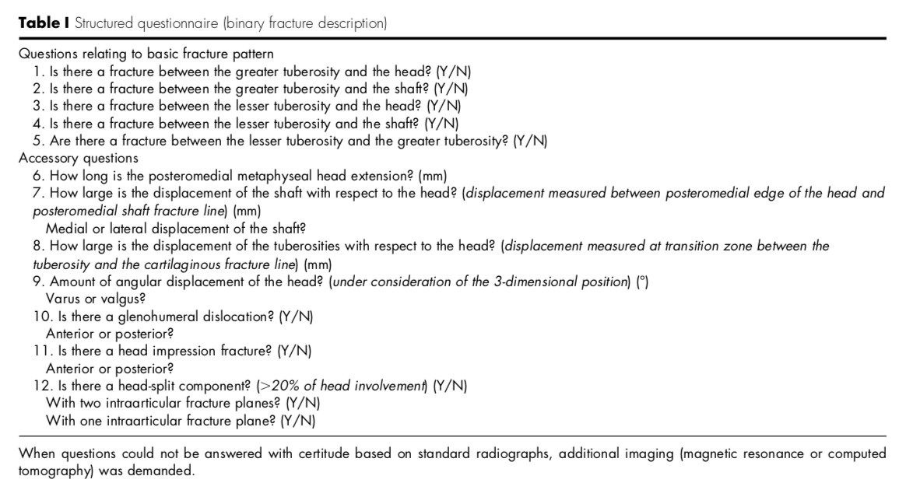
Predictors of humeral head ischemia after intracapsular fracture of the proximal humerus Prospective Observational Study, JSES, 2004, Hertel et al.
METHODS – Fracture Morphology

Slide 23
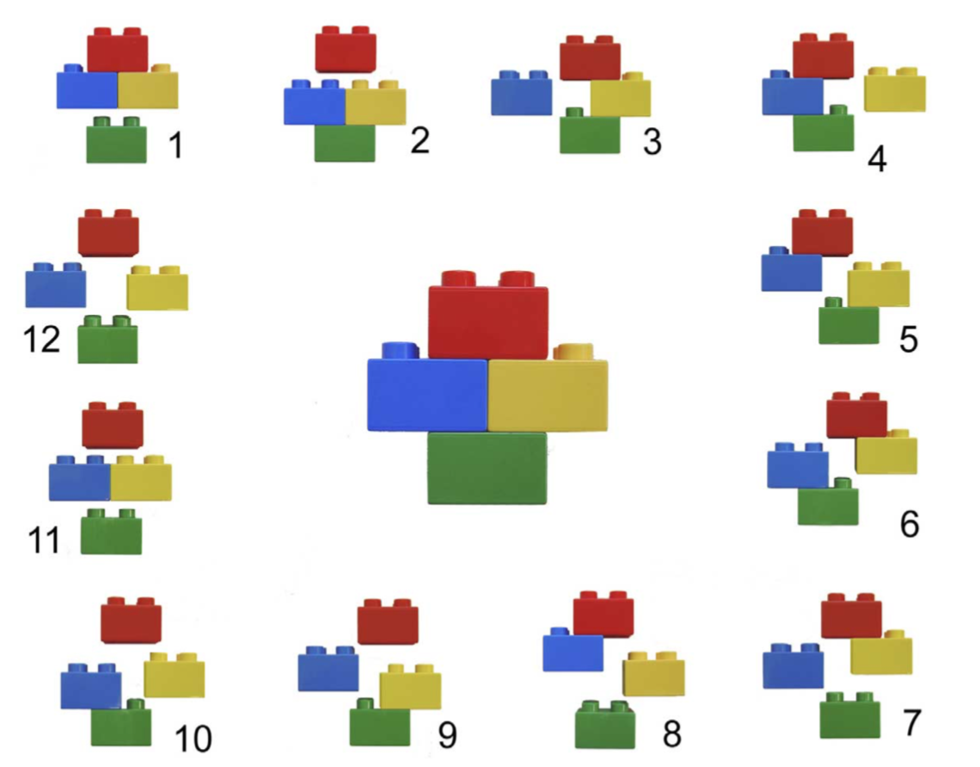
Predictors of humeral head ischemia after intracapsular fracture of the proximal humerus Prospective Observational Study, JSES, 2004, Hertel et al.
METHODS – Fracture Morphology
From these questions, 12 basic fracture patterns emerged:
Notes:
Binary (LEGO) description system. Combining the 5 basic fracture planes results in 12 basic fracture patterns. Basic fracture planes lie between the greater tuberosity and the head, the greater tuberosity and the shaft, the lesser tuberosity and the head, the lesser tuberosity and the shaft, and the lesser tuberosity and the greater tuberosity. There are 6 possible fractures dividing the humerus into two fragments, 5 possible fractures dividing the humerus into three fragments, and a single fracture dividing the humerus into four fragments.

Slide 24
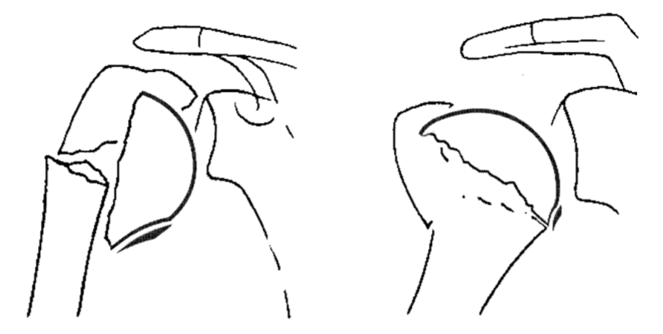
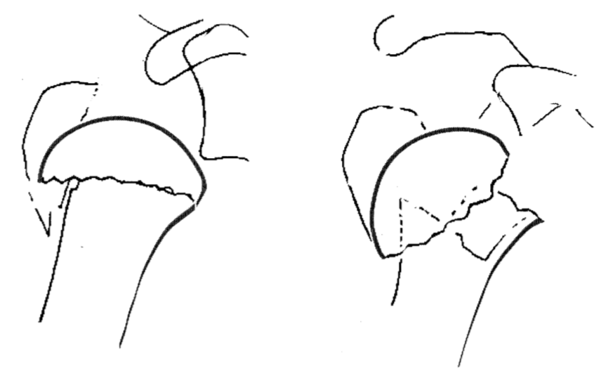
Predictors of humeral head ischemia after intracapsular fracture of the proximal humerus Prospective Observational Study, JSES, 2004, Hertel et al.
METHODS – Fracture Morphology
Accessory criteria:
Length of the medial metaphyseal head extension
Integrity of the medial hinge
Head-split components: classic and special

Slide 25
Predictors of humeral head ischemia after intracapsular fracture of the proximal humerus Prospective Observational Study, JSES, 2004, Hertel et al.
METHODS – Perfusion
Established intraoperatively by observed backflow after centrally drilling humeral head with 2.5 mm drill bit
Proof of positive perfusion:
Clear backflow while suction applied to base of head
Pulsatile laser Doppler in drill hole (assessed in 46/100 shoulders)

Slide 26
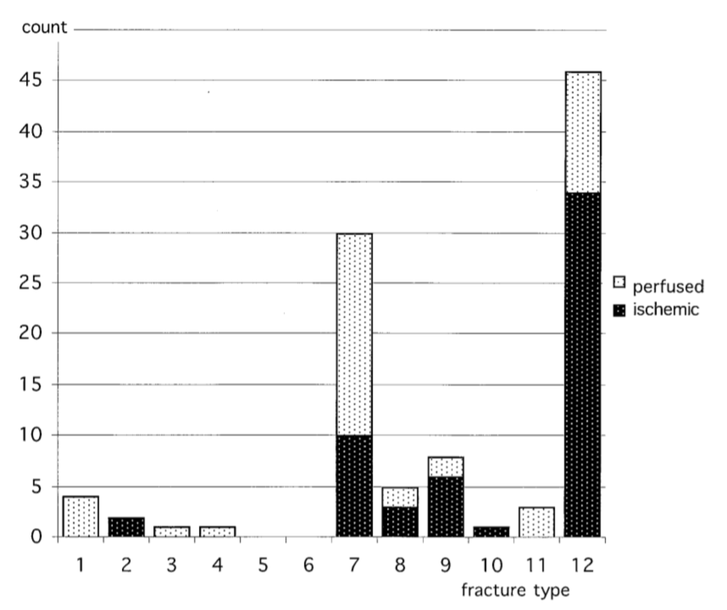
Predictors of humeral head ischemia after intracapsular fracture of the proximal humerus Prospective Observational Study, JSES, 2004, Hertel et al.
RESULTS: 55 heads were ischemic, 45 were perfused

Slide 27
Predictors of humeral head ischemia after intracapsular fracture of the proximal humerus Prospective Observational Study, JSES, 2004, Hertel et al.
RESULTS
Notes:
Significant p values highlighted in yellow

Slide 28
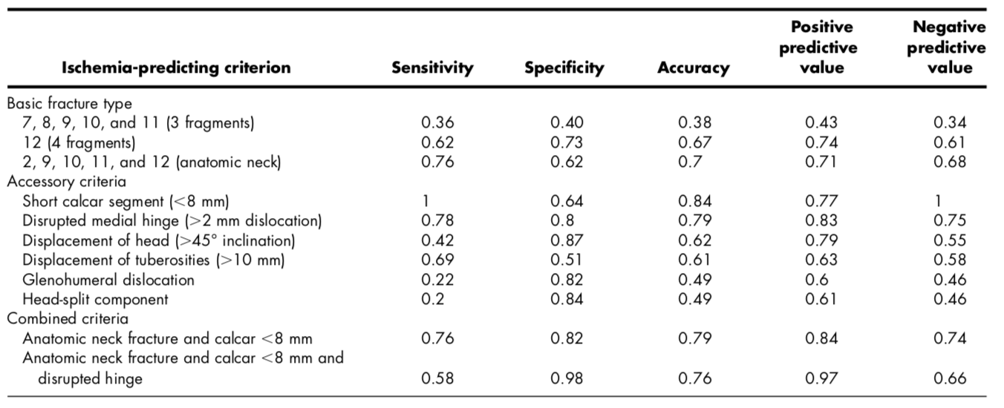
Predictors of humeral head ischemia after intracapsular fracture of the proximal humerus Prospective Observational Study, JSES, 2004, Hertel et al.
RESULTS – Combining anatomic neck, short calcar, and disrupted hinge → 97% positive predictive value
Notes:
Good predictors of ischemia are the ones highlighted

Slide 29
Predictors of humeral head ischemia after intracapsular fracture of the proximal humerus Prospective Observational Study, JSES, 2004, Hertel et al.
CONCLUSIONS
The most relevant predictors of ischemia:
Length of dorsomedial metaphyseal extension (< 8 mm)
Integrity of medial hinge (> 2 mm dislocation)
Basic fracture type as classified by a binary description system
Degree of fragment displacement is less important than previously thought
Prior overemphasis on the dominance of the anterior circumflex vessels – perfusion from the posterior circumflex vessels alone appears sufficient for head survival
Notes:
“We would like to thank the LEGO Company, Denmark, for allowing us to use their bricks for didactic purposes."

Slide 30
Predictors of humeral head ischemia after intracapsular fracture of the proximal humerus Prospective Observational Study, JSES, 2004, Hertel et al.
WHAT MAKES THIS SPECIAL
Identifies easily ascertainable risk factors for humeral head ischemia
Questions vascular predominance of the anterior circumflex vessels
Demonstrates that a binary fracture description system is straightforward and has clinical value
Notes:
Furhtermore, sets the stage to determine which fractures might go on to fail ORIF even if performed properly

Slide 31
The Importance of Medial Support in Locked Plating of Proximal Humerus Fractures Prospective Observational Study, JOT, 2007, Gardner et al.
BACKGROUND
Traditional lateral plate fixation of comminuted proximal humerus fractures is only moderately successful
Because of medial vasculature, locking plates are placed on the lateral humerus; however, this positioning requires that fixed-angle screws serve as perpendicular struts
PURPOSE:
Evaluate the radiographic behavior of proximal humerus fractures
Elucidate how patient factors, fracture patterns, reduction variables, and implant placements affect mechanical stability
Notes:
Sandler

Slide 32
The Importance of Medial Support in Locked Plating of Proximal Humerus Fractures Prospective Observational Study, JOT, 2007, Gardner et al.
METHODS
Consecutive series of 35 patients
Inclusion criteria: adults with acute traumatic fractures of the proximal humerus that underwent ORIF with a locking plate and had adequate preoperative/postoperative radiographs
2-part (n = 6) with 100% displacement, varus malalignment with medial cortical comminution
3-part (n = 15)
4-part (n = 14)
Mean follow up: 7 months (6 – 77 weeks)

Slide 33
The Importance of Medial Support in Locked Plating of Proximal Humerus Fractures Prospective Observational Study, JOT, 2007, Gardner et al.
METHODS – Surgical Technique
Deltopectoral or anterolateral acromial approach
Rotator cuff secured to separate holes in locking plate with suture
At least 5 locking screws in proximal fragment
An additional 1 – 2 compression screws were used in several younger patients to assist with reduction

Slide 34
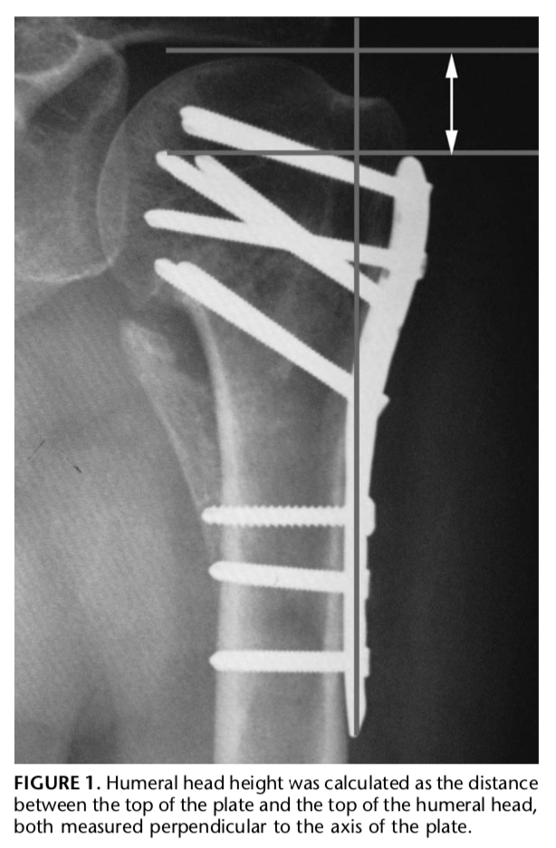
The Importance of Medial Support in Locked Plating of Proximal Humerus Fractures Prospective Observational Study, JOT, 2007, Gardner et al.
METHODS – Radiographic Measurements
Humeral head height (Figure 1)
Perpendicular to top edge of plate
Perpendicular to superior edge of humeral head

Slide 35
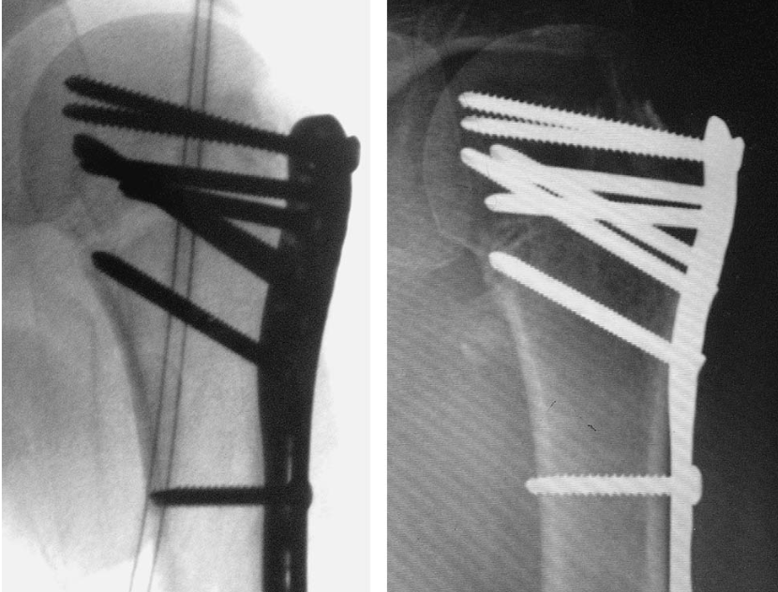
The Importance of Medial Support in Locked Plating of Proximal Humerus Fractures Prospective Observational Study, JOT, 2007, Gardner et al.
METHODS – Radiographic Measurements
Humeral head height
Adequate medial support (+MS) had one of the following:
Medial pillar reduced and non-comminuted (Figure 2)
Shaft medialized, impacted into head
Oblique locking screw in inferomedial quadrant of proximal humeral head fragment to within 5 mm subchondral bone

Slide 36
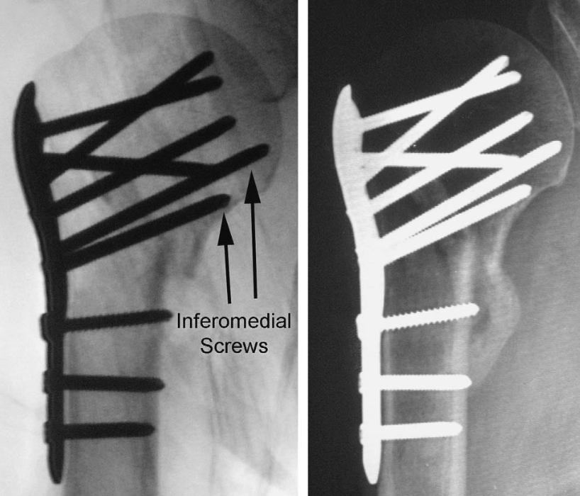
The Importance of Medial Support in Locked Plating of Proximal Humerus Fractures Prospective Observational Study, JOT, 2007, Gardner et al.
METHODS – Radiographic Measurements
Humeral head height
Adequate medial support (+MS) had one of the following:
Medial pillar reduced and non-comminuted (Figure 2)
Shaft medialized, impacted into head
Oblique locking screw in inferomedial quadrant of proximal humeral head fragment to within 5 mm subchondral bone

Slide 37
The Importance of Medial Support in Locked Plating of Proximal Humerus Fractures Prospective Observational Study, JOT, 2007, Gardner et al.
RESULTS
+ MS (n = 18) | - MS (n = 17)
CRITERIA 1: Anatomic reduction of medial cortex and non-comminuted (n = 9) CRITERIA 2: shaft medialized, impacted into head (n = 3) CRITERIA 3: one or two inferomedial screws placed (n = 6) Criteria 1 + 3 met (n = 3) | Malreduction with lateral displacement of the shaft fragment (n = 12) Medial comminution (n = 5) No patient had a screw placed in the inferomedial region

Slide 38
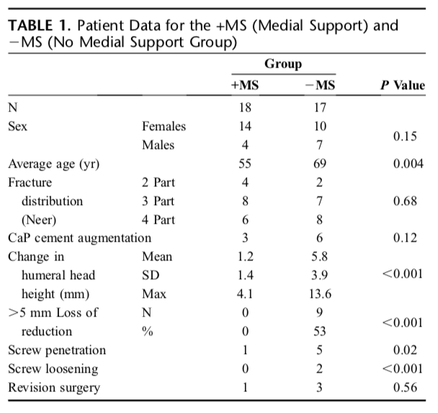
The Importance of Medial Support in Locked Plating of Proximal Humerus Fractures Prospective Observational Study, JOT, 2007, Gardner et al.
RESULTS
-MS was a significant predictor of loss of fracture reduction
Subgroup analysis showed no significant change in humeral head height between 3 and 6 month follow up (average 0.3 mm)

Slide 39
The Importance of Medial Support in Locked Plating of Proximal Humerus Fractures Prospective Observational Study, JOT, 2007, Gardner et al.
RESULTS – Complications
+ MS
Inferomedial screw penetration through humeral head (n = 1): revision at 3 months postoperatively
- MS
Screw penetration of articular surface (n = 5)
Loosening of other screws (n = 2)
Revision for screw removal (n = 2)
Revision to longer plate for screw pullout (n = 1)
Persistent wound draining requiring irrigation and debridement (n = 1)

Slide 40
The Importance of Medial Support in Locked Plating of Proximal Humerus Fractures Prospective Observational Study, JOT, 2007, Gardner et al.
CONCLUSIONS
Sufficient medial mechanical support of the proximal humeral head fragment is critical to maintain reduction after locked plating
Locking screws cannot stabilize medial column. Requires:
Anatomic reduction → cortical contact
Inferomedial screw placement

Slide 41
The Importance of Medial Support in Locked Plating of Proximal Humerus Fractures Prospective Observational Study, JOT, 2007, Gardner et al.
WHAT MAKES THIS SPECIAL
Offers insight into the the role of locking plates for proximal humerus fractures
Identifies the vital mechanical requirements that are requisite for stable fixation and describes a specific standard for how to achieve them
Anatomic reduction
Inferomedial screw placement

Slide 42
Reverse shoulder arthroplasty for the treatment of three- and four-part fractures of the proximal humerus in the elderly Prospective Observational Study, JBJS, 2007, Bufquin et al.
BACKGROUND
High risk of avascular necrosis in three- and four-part proximal humerus fractures renders reverse shoulder arthroplasty (RSA) a reasonable treatment option
Historical context of RSA in 2007:
Showed promising mid-term outcomes in patients with degenerative or inflammatory shoulder disease
Beginning to show acceptable mid-term outcomes in trauma patients (Boileau et al., 2006; Cazeneuve et al., 2006)
PURPOSE: describe short-term outcomes after RSA for Neer 3- and 4-part proximal humerus fractures in patients over 65
Notes:
Scanaliato
Thiss builds upon what Hertel propose (and, to a lesser extent, Boileau with the hemi paper)

Slide 43
Reverse shoulder arthroplasty for the treatment of three- and four-part fractures of the proximal humerus in the elderly Prospective Observational Study, JBJS, 2007, Bufquin et al.
METHODS
Consecutive series of 41 patients over 65 with proximal humerus fractures
Three-part fracture = 5
Four-part fracture = 38 (12 with associated dislocation)
Exclusion criteria: active infection, axillary nerve palsy, deficient deltoid muscle, bone tumor
Mean follow up 22 months (range 6 - 58)

Slide 44
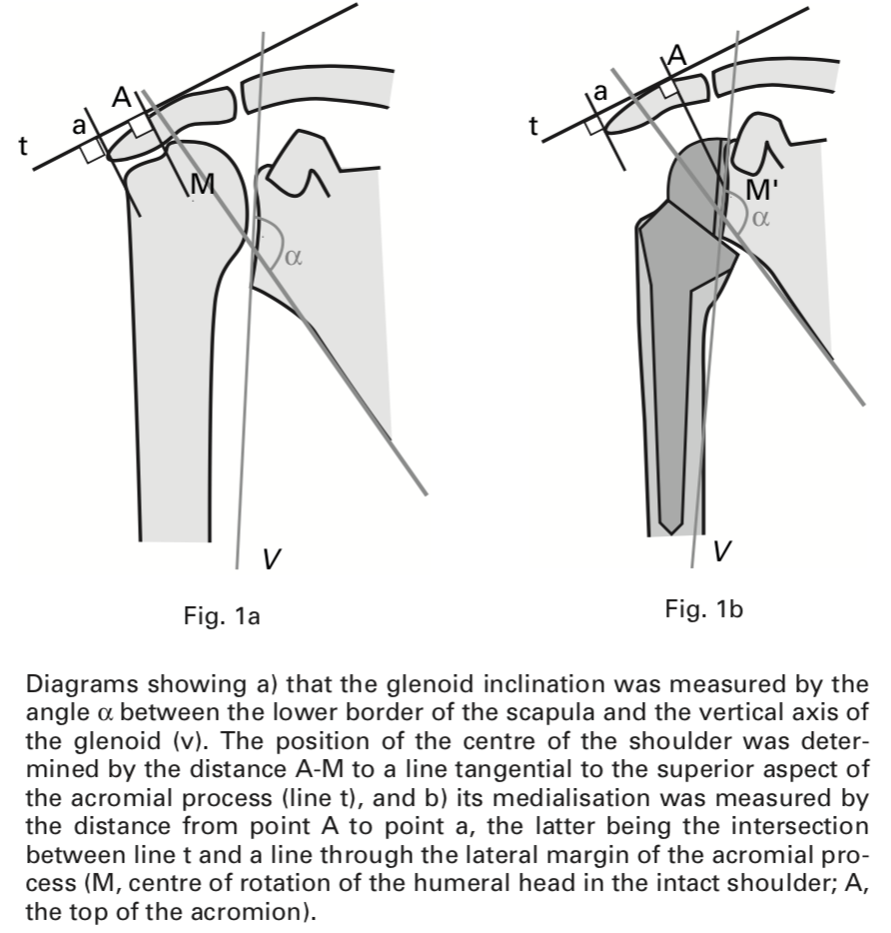
Reverse shoulder arthroplasty for the treatment of three- and four-part fractures of the proximal humerus in the elderly Prospective Observational Study, JBJS, 2007, Bufquin et al.
METHODS – Surgical Technique
Superolateral approach in first 20 patients, deltopectoral in remaining 23
Glenoid baseplate implanted flush to inferior rims with 10 degrees inferior inclination and secured with four lag screws (Fig 1a, 1b)
Humeral component initially positioned in retroversion but converted to neutral version to increase internal rotation
Epiphyseal augment to improve deltoid tension in 15 patients

Slide 45
Reverse shoulder arthroplasty for the treatment of three- and four-part fractures of the proximal humerus in the elderly Prospective Observational Study, JBJS, 2007, Bufquin et al.
METHODS – Radiographic Measurements
Center of rotation considered inferiorly depressed if difference between [A to M] [A to M’] was >10 mm
Medialization of shoulder defined as distance from [A to a] across tangent line [t] was >10 mm
Inclination angle (angle ⍺) from intersection of lower scapular border and vertical glenoid axis

Slide 46
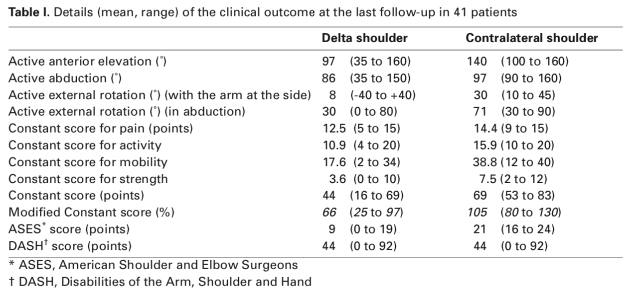
Reverse shoulder arthroplasty for the treatment of three- and four-part fractures of the proximal humerus in the elderly Prospective Observational Study, JBJS, 2007, Bufquin et al.
RESULTS
Clinical results not affected by approach or healing of tuberosities
Mean medialization 21 mm (range = 0 – 35) vs contralateral
Mean center of rotation 9 mm (range 0 – 17) inferior vs contralateral
Notes:
Note that constant score for pain is 0 – 15 with 0 = worst and 15 = no pain

Slide 47
Reverse shoulder arthroplasty for the treatment of three- and four-part fractures of the proximal humerus in the elderly Prospective Observational Study, JBJS, 2007, Bufquin et al.
RESULTS
Secondary displacement in 19/36 (53%) of shoulders with tuberosity fixation
Malunion in 5 (13.8%)
Nonunion in 14 (38.8%)
Scapular notching in 10 shoulders (25%)
Generally noted in first year and did not worsen by end of second
Average inclination 15 degrees greater than contralateral, no correlation with grade of notching
Heterotopic ossification in 36 shoulders (90%)

Slide 48
Reverse shoulder arthroplasty for the treatment of three- and four-part fractures of the proximal humerus in the elderly Prospective Observational Study, JBJS, 2007, Bufquin et al.
RESULTS – Complications
Neurological (n = 5): residual finger paresthesias at follow up in 2
Reflex sympathetic dystrophy (n = 3): resolved spontaneously
Glenoid fracture (n = 1): secondary to reaming, treated with revision baseplate
Non-traumatic anterior dislocation (n = 1): 6 weeks → humeral articulation with coracoid. Declined further surgery
Acromion fracture (n = 1): 12 months postoperatively, healed uneventfully
Separation of anterior muscular flap (n = 1): revised at 17 months

Slide 49
Reverse shoulder arthroplasty for the treatment of three- and four-part fractures of the proximal humerus in the elderly Prospective Observational Study, JBJS, 2007, Bufquin et al.
CONCLUSIONS
Just like anatomic procedures, RSA provides excellent pain relief for treating proximal humerus fractures
Patients >75: potentially improved functional recovery
Patients 65 – 75: biomechanical medialization and inferior displacement of shoulder center reduces consequences of failed tuberosity reconstruction
Biggest challenge was fixation of tuberosities in anatomic position, which is the main prognostic factor influencing recovery
No complications caused major problems. Similar rates of transient neurological complications as seen in prior literature

Slide 50
Reverse shoulder arthroplasty for the treatment of three- and four-part fractures of the proximal humerus in the elderly Prospective Observational Study, JBJS, 2007, Bufquin et al.
WHAT MAKES THIS SPECIAL
One of the early papers reporting outcomes of RSA for proximal humerus fractures
Comparable to anatomic SA
May offer improved recovery and biomechanical advantage for certain patient populations

Slide 51
Open Reduction and Internal Fixation of Proximal Humeral Fractures with Use of the Locking Proximal Humerus Plate Prospective, Multicenter Observational Study, JBJS, 2009, Südkamp et al.
BACKGROUND
Treatment for displaced and unstable fractures is controversial
Options include ORIF, HA, pinning, screw osteosynthesis, and IM nails, but all portend persistent risks
ORIF specifically has unpredictable results in patients with osteopenia and/or comminuted fracture patterns
Locking plates offer a biomechanical advantage but there are few prospective studies describing outcomes
PURPOSE: assess outcomes and complications after ORIF of proximal humerus fractures with the Locking Proximal Humerus Plate
Notes:
Sandler
Over 70% of patients with proximal humerus fracture are over 60 years old and 75% are female; subsequently,

Slide 52
Open Reduction and Internal Fixation of Proximal Humeral Fractures with Use of the Locking Proximal Humerus Plate Prospective, Multicenter Observational Study, JBJS, 2009, Südkamp et al.
METHODS
Consecutive series of 187 patients at nine international trauma units
Inclusion criteria:
Neer’s criteria: >45° angulation or >1 cm segment displacement
Unstable passive motion with use of an image intensifier
Exclusion criteria: prior proximal humerus surgery, concomitant ipsilateral distal humerus or elbow injury, polytrauma with an Injury Severity Score of >16, disorders that affect healing, and posttraumatic brachial plexus injury or peripheral nerve palsy

Slide 53
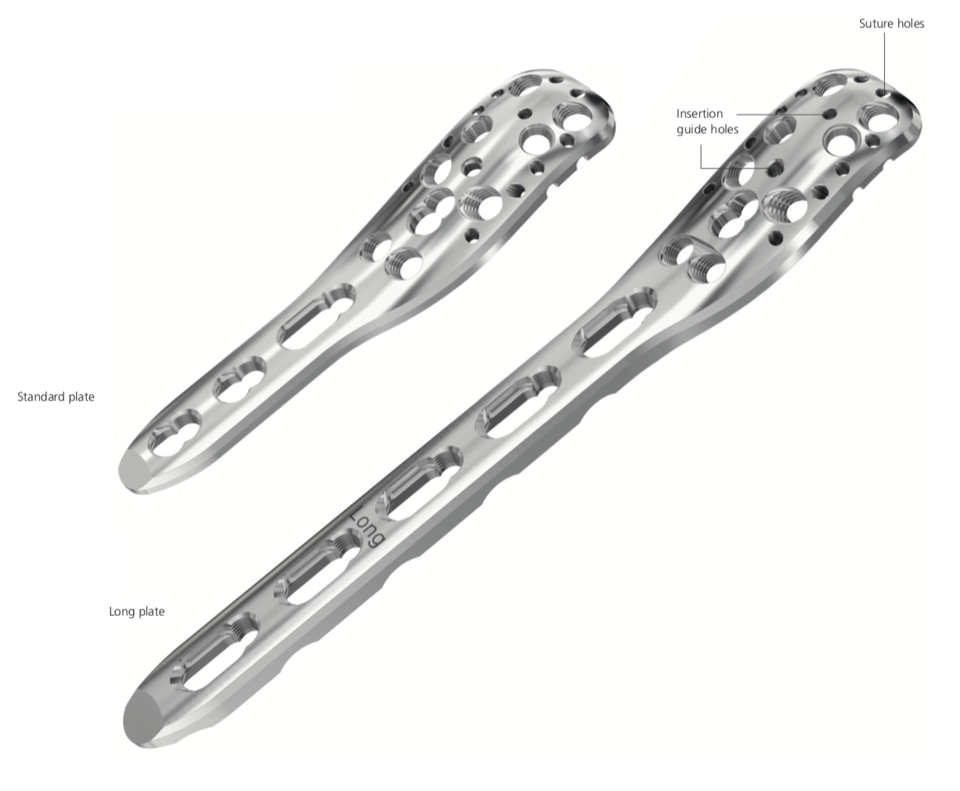
Open Reduction and Internal Fixation of Proximal Humeral Fractures with Use of the Locking Proximal Humerus Plate Prospective, Multicenter Observational Study, JBJS, 2009, Südkamp et al.
METHODS – Locking Plate
Synthes (Oberdorf, Switzerland), developed by AO foundation
Contoured to lateral humeral metaphysis and diaphysis
Multidirectional locking screws in humeral head
Combination holes for locking or nonlocking screws in shaft
Smaller holes for wire or suture fixation of GT and LT reattachment
Available in either five or eight combination hole sizes
Notes:
http://synthes.vo.llnwd.net/o16/LLNWMB8/US%20Mobile/Synthes%20North%20America/Product%20Support%20Materials/Technique%20Guides/DSUSTRM10161133%20Rev%20B.pdf

Slide 54
Open Reduction and Internal Fixation of Proximal Humeral Fractures with Use of the Locking Proximal Humerus Plate Prospective, Multicenter Observational Study, JBJS, 2009, Südkamp et al.
METHODS – Surgical Technique
Deltopectoral (n = 160) or deltoid-splitting (n = 27) approach
Fracture reduced and stabilized with K-wires, confirmed by imaging
Plate positioned 5 – 8 mm distal to upper end of GT and 2 mm posterior to bicipital groove
Angular stable screws into humeral head
Angular stable or standard cortical screws into shaft at surgeon’s discretion
Final imaging to verify screw placement at surgeon’s discretion

Slide 55
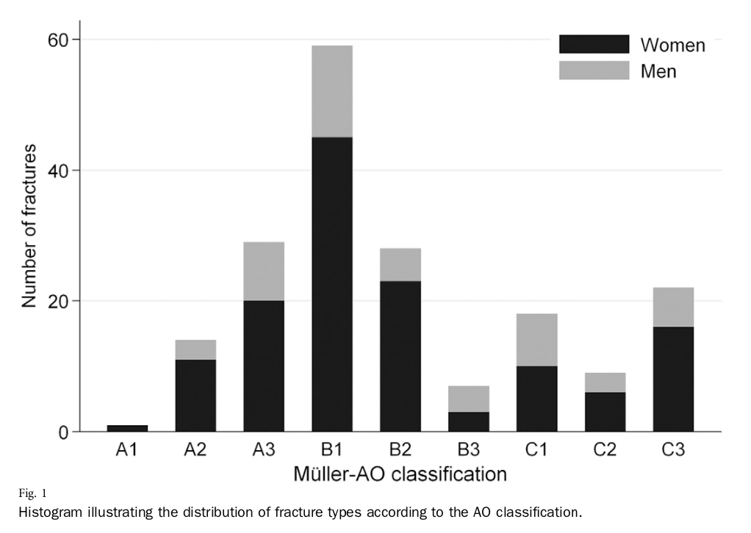
Open Reduction and Internal Fixation of Proximal Humeral Fractures with Use of the Locking Proximal Humerus Plate Prospective, Multicenter Observational Study, JBJS, 2009, Südkamp et al.
RESULTS – 72% female, women significantly older than men (67 versus 52)

Slide 56
Open Reduction and Internal Fixation of Proximal Humeral Fractures with Use of the Locking Proximal Humerus Plate Prospective, Multicenter Observational Study, JBJS, 2009, Südkamp et al.
RESULTS
Technique
Five-hole plate in 90% (n = 169), eight-hole plate in 10% (n = 18)
Plate-independent lag screws in 17% (n = 31)
GT or LT stabilization with sutures in 59% (n = 110)
Mean operative time was 97 ± 44 minutes
A: mean 94 min
B: mean 84 min
C: mean 124 min

Slide 57
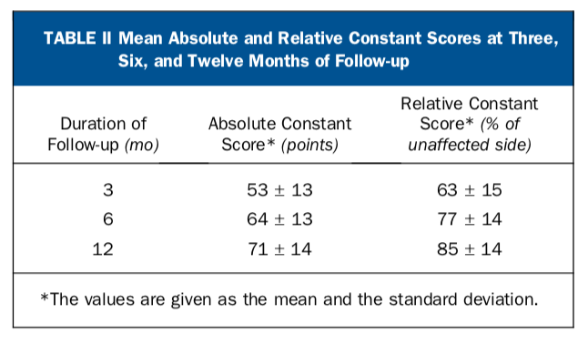
Open Reduction and Internal Fixation of Proximal Humeral Fractures with Use of the Locking Proximal Humerus Plate Prospective, Multicenter Observational Study, JBJS, 2009, Südkamp et al.
RESULTS – Outcomes
ROM and constant scores increased significantly over the follow up period
No significant differences between the AO fracture types

Slide 58
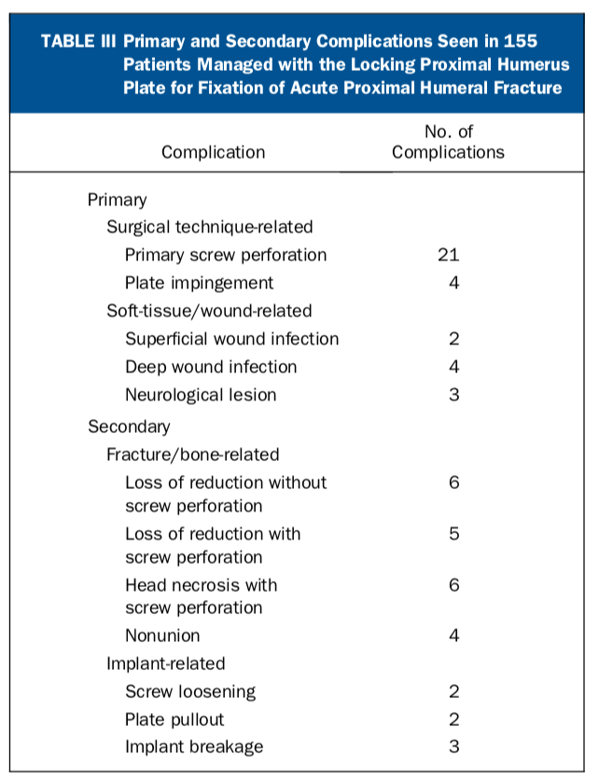
Open Reduction and Internal Fixation of Proximal Humeral Fractures with Use of the Locking Proximal Humerus Plate Prospective, Multicenter Observational Study, JBJS, 2009, Südkamp et al.
RESULTS – Complications
Complication rate: 34% (n = 52)
Reoperation rate: 19% (n = 29)
Secondary screw perforation in (n = 15)
Infection-related revision (n = 4)
Repeat osteosynthesis with bone grafting after plate breakage or pullout (n = 4)
Exchange for shorter screws (n = 3)
Conversion to SA (n = 3)

Slide 59
Open Reduction and Internal Fixation of Proximal Humeral Fractures with Use of the Locking Proximal Humerus Plate Prospective, Multicenter Observational Study, JBJS, 2009, Südkamp et al.
CONCLUSIONS
Overall reliable results for internal fixation of proximal humerus fractures with the Locking Proximal Humerus Plate when used correctly
Notably high complication and reoperation rates, but most are related to surgical technique
Over 40% of all complications were already present at the end of the procedure
Recommend a final image intensifier check with humeral head rotation to ensure proper screw placement

Slide 60
Open Reduction and Internal Fixation of Proximal Humeral Fractures with Use of the Locking Proximal Humerus Plate Prospective, Multicenter Observational Study, JBJS, 2009, Südkamp et al.
WHAT MAKES THIS SPECIAL
Locking plate offers a viable option in treating proximal humerus fractures
Importance of good technique and screw placement is critical to success and cannot be overstated

