Slide 1
Prospective Randomized Clinical Evaluation of Conventional Single-Bundle, Anatomic Single-Bundle, and Anatomic Double-Bundle Anterior Cruciate Ligament Reconstruction
Mohsen Hussein, Carola F. van Eck, Andrej Cretnik,
Dejan Dinevski, Freddie H. Fu
Presentation by: Ehab Nazzal, MD

Slide 2
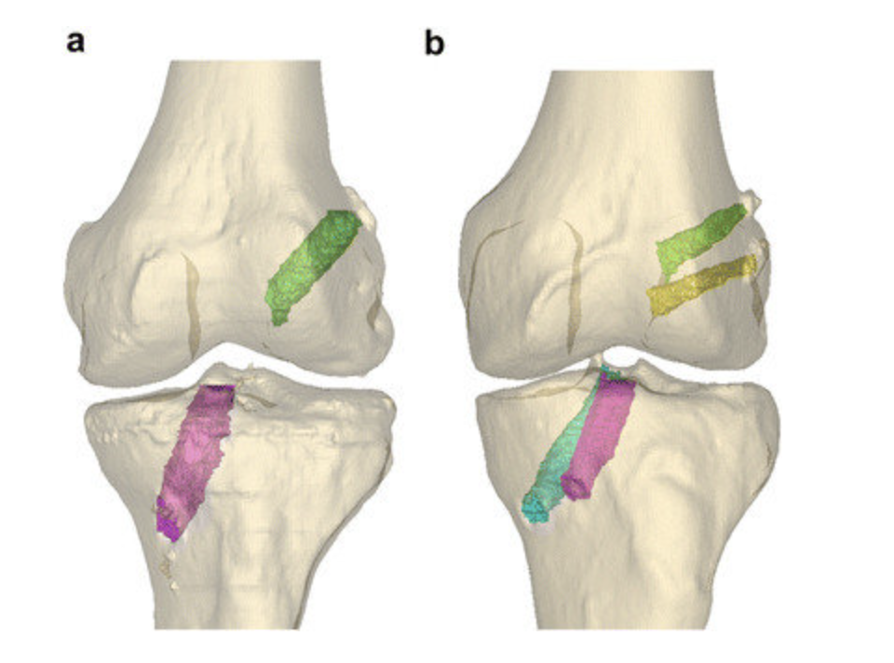
Background
Conventional (transtibial) ACL reconstruction restores anterior tibial translation but insufficient restoration of rotatory stability
Previous biomechanical studies showed Anatomic DB ACLR restores knee stability closer to normal than conventional SB ACLR
Conflicting literature based on lack of specifying whether transtibial or anatomic technique was used
Failure to identify these techniques in studies may introduce confounding results based on tunnel mismatch, which results in:
Abnormal knee kinematics
Limiting ROM
Increased graft tension
Impaired healing of graft-bone interface
Graft Failure
SB v DB ACLR -- Figure from: Aga et al. KSSTA 2016

Slide 3
Purpose and Hypothesis
Goal: Compare results of three different techniques of ACLR
Conventional SB
Anatomic SB
Anatomic DB
Determine if DB ACLR is needed to restore rotational stability or if anatomic placement of SB ACLR can yield similar results
Hypotheses:
Anatomic SB ACLR is superior to conventional SB ACLR
Anatomic DB ACLR is superior to both conventional and anatomic SB ACLR

Slide 4
Methods
Prospective Randomized Clinical Study
3 groups
CSB (n = 85)
ASB (n = 85)
ADB (n = 160)
Inclusion:
ACL rupture in active patients with closed growth plate
Exclusion:
Multiligamentous injuries
Grade 3 or greater OA
Meniscectomy
Contralateral ACL deficient knee
Partial ACL rupture
Measured Outcomes:
Anterior tibial translation (SSD with KT-1000)
Rotational stability (Pivot Shift)
Knee ROM
Lysholm Score
Subjective IKDC
Objective IKDC

Slide 5
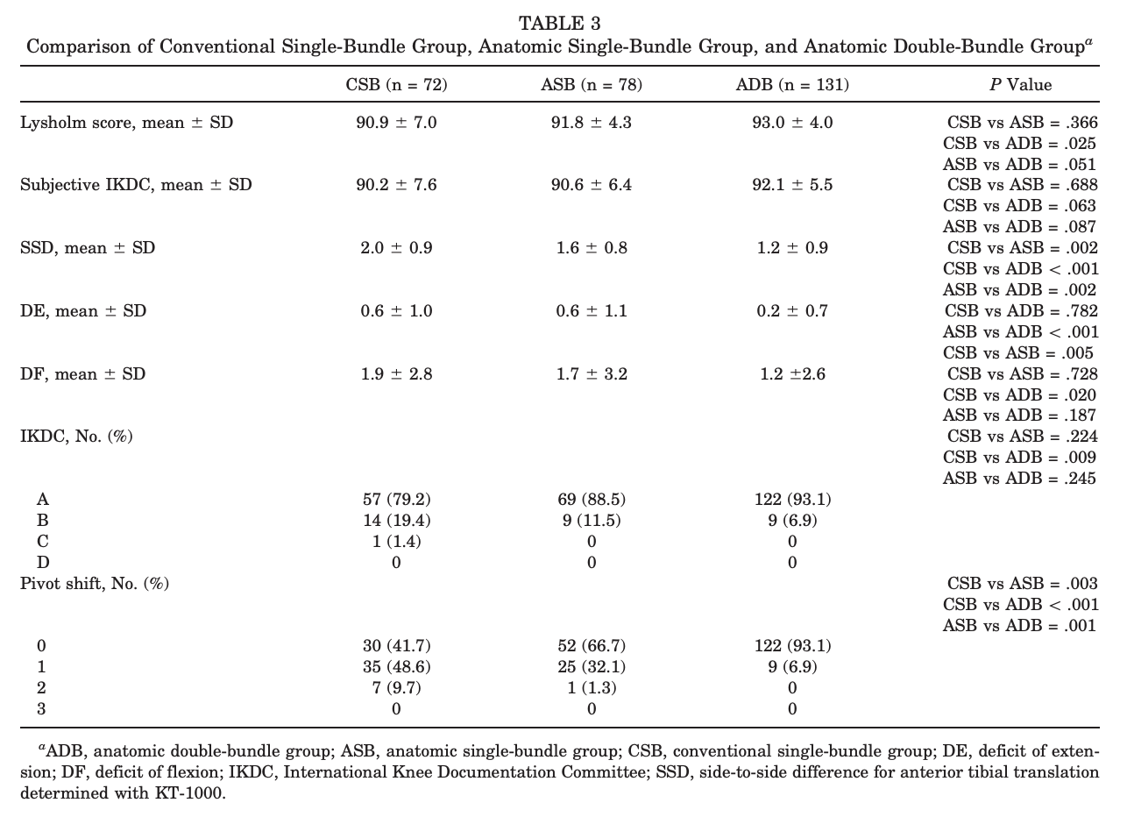
Results – CSB v ASB
ASB superior to CSB for AP and rotational stability
No difference in Lysholm and subjective IKDC

Slide 6
Results – CSB v ADB
ADB superior to CSB for all measured outcomes except subjective IKDC

Slide 7
Results – ASB v ADB
ADB superior to ASB for AP, rotational stability, and knee ROM
No differences between groups for Lysholm score, subjective IKDC, or objective IKDC

Slide 8
Discussion and Conclusion
Overall:
ADB is superior to both CSB and ASB ASB is superior to CSB
Implies most important factor is performing ACL reconstruction anatomically
Limitations:
No individualization of surgery (i.e reconstruction, graft type/size depending on insertional site morphology)
Could not individualize due to randomization
Future studies:
Repeat comparisons with more individualization in order to more accurately perform tunnel placement to make the procedure “more anatomic”

Slide 9
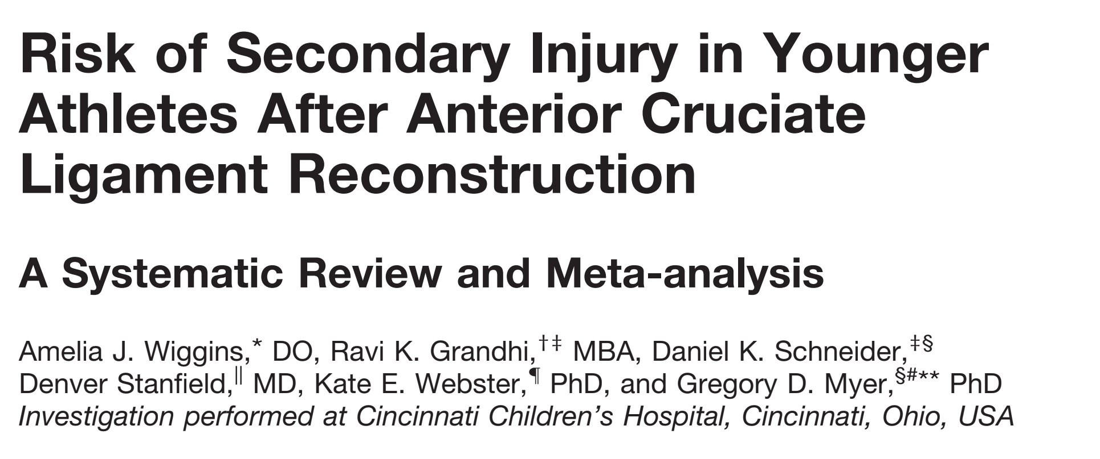
Presented by Tyler Thorne, BA

Slide 10
Background
Following anterior cruciate ligament (ACL) reconstruction injury to the ipsilateral or contralateral ACL is a disastrous but known outcome
Graft failure rates range from 3%-25%
Despite this high occurrence rate; risk factors for graft failure and contralateral ACL rupture are not clear

Slide 11
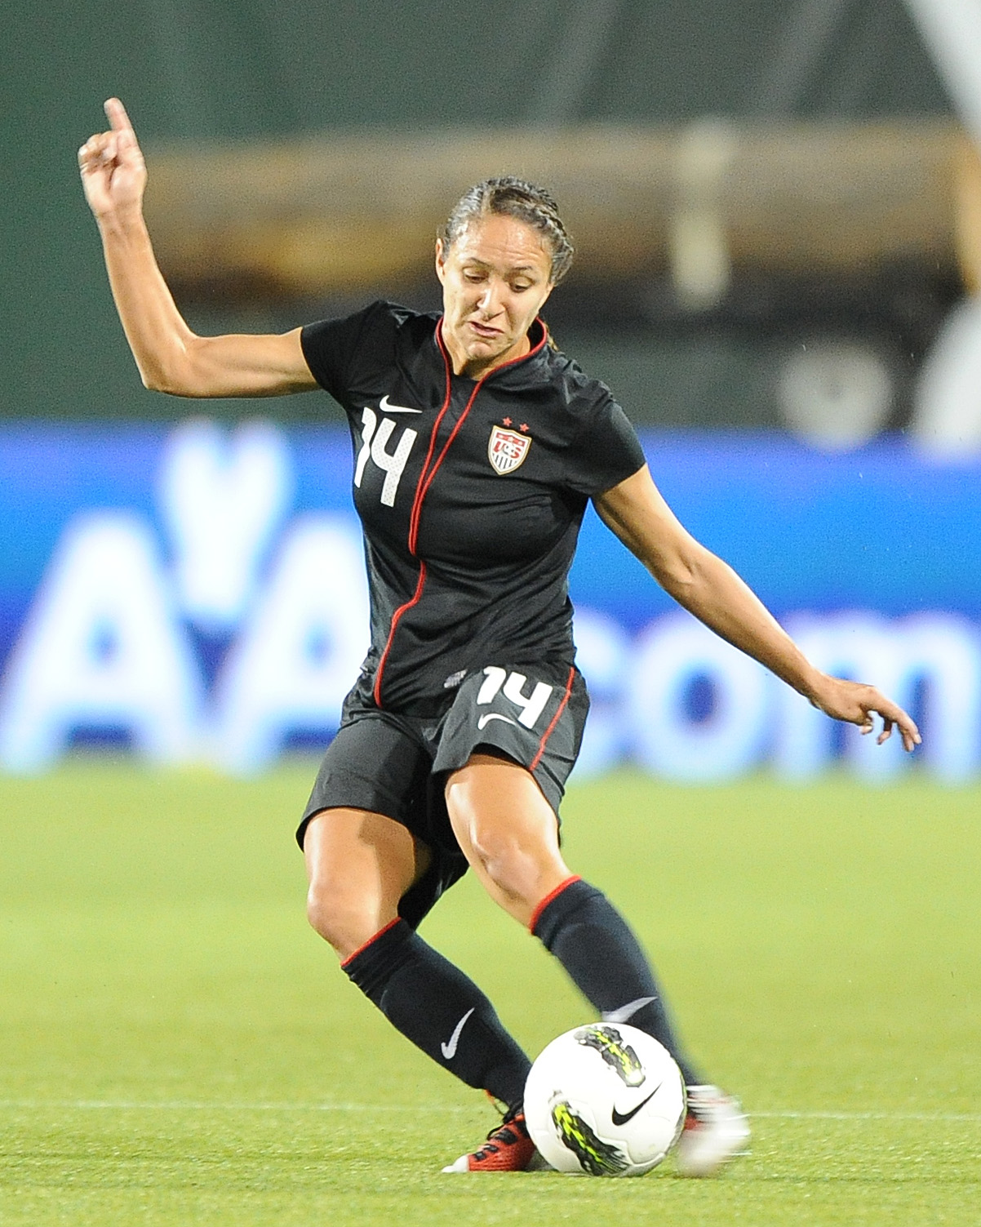
Purpose
Meta-analysis to assess risk factors of age and activity level after ACL reconstruction (ACLR) in secondary ACL injury.
Hypothesis: Young age and return to sport would increase secondary ACL injury risk
Notes:
Can we use stock images? Or is it better to take this out to avoid copyright issues?

Slide 12
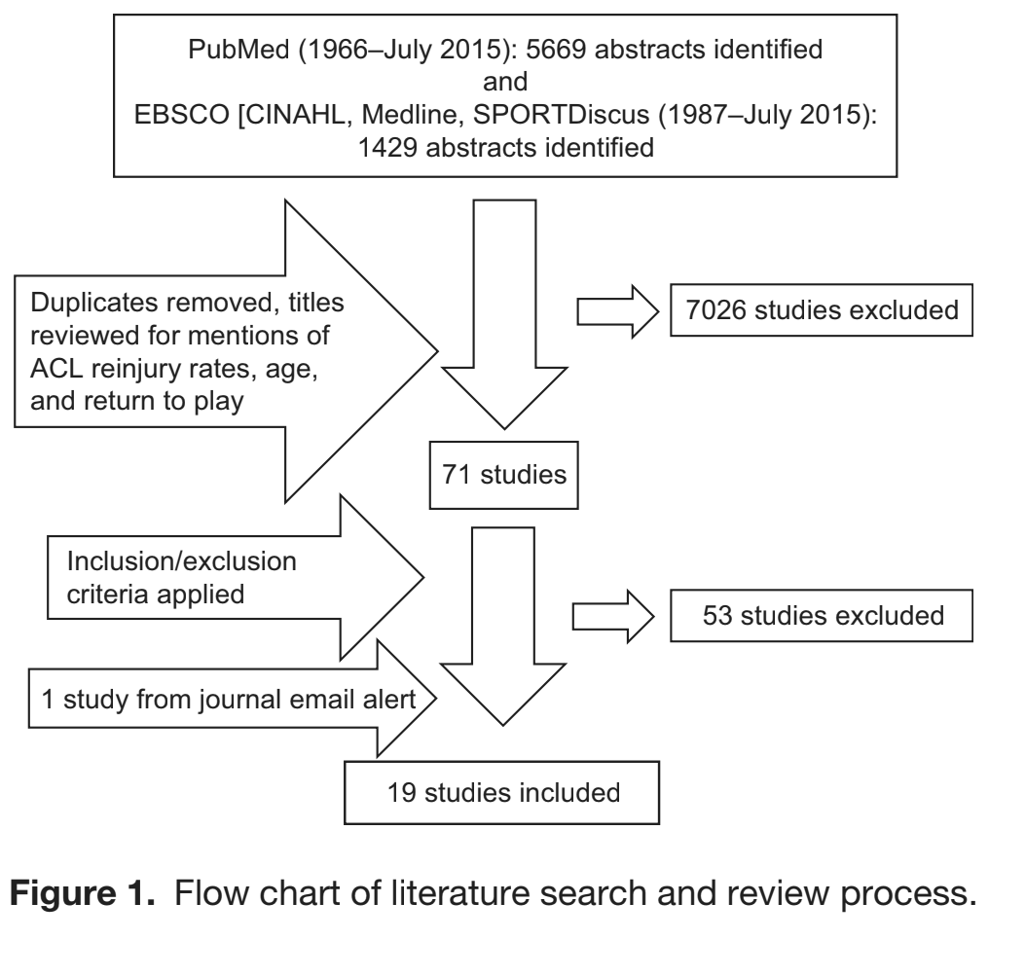
Methods
Searched PubMed and EBSCO host (CINAHL, Medline, SPORTDiscus)
Terms- ACL, anterior cruciate ligament, acl reconstruction return to sport, acl reconstruction outcomes, acl risk factors, revision acl risk factors, contralateral acl risk factors, and age acl risk factors ​
Level of evidence ranged from 2-4
Included study, including level of evidence, number of patients, patient demographics, outcome measure of surgery or injury, and reinjury rate for ipsilateral side, contralateral side, and total. ​

Slide 13
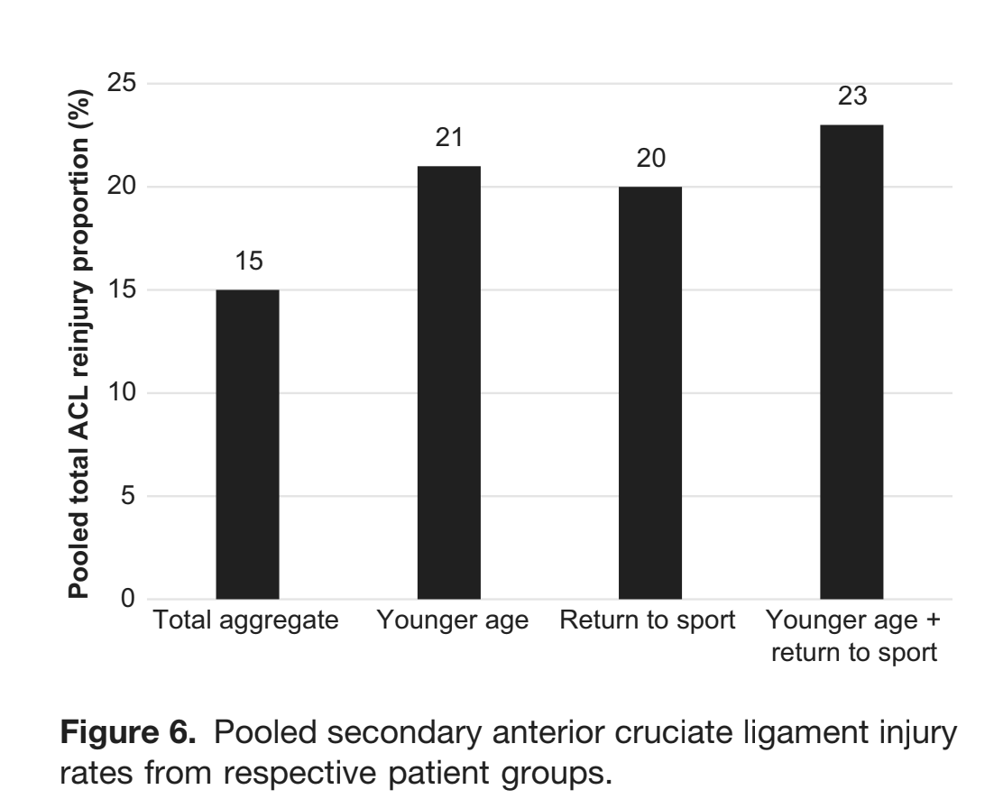
Results
Total second ACL reinjury rate was 15%
Ipsilateral reinjury rate of 7% and a contralateral injury rate of 8%
Patients <25 years old had a secondary ACL injury rate of 21% (ipsilateral + contralateral)
Secondary ACL injury rate for athletes returning to a sport was 20%
Secondary ACL injury rate for athletes younger than 25 years old who return to sport was 23%

Slide 14
Conclusion
Younger age (<25) and returning to sport are associated with a high risk of secondary ACL injury.
Data shows nearly 1 in 4 young athletes returning to play will have a secondary ACL injury
Limitations: inadequate reporting of secondary ACL injuries, lack of standardized information about patients follow-up, rehab status, graft size/type, and surgical technique.
Future:
Still significant risk of reinjury following rehab protocols
Further investigation is needed to evaluate rehab therapy protocol guidelines

Slide 15
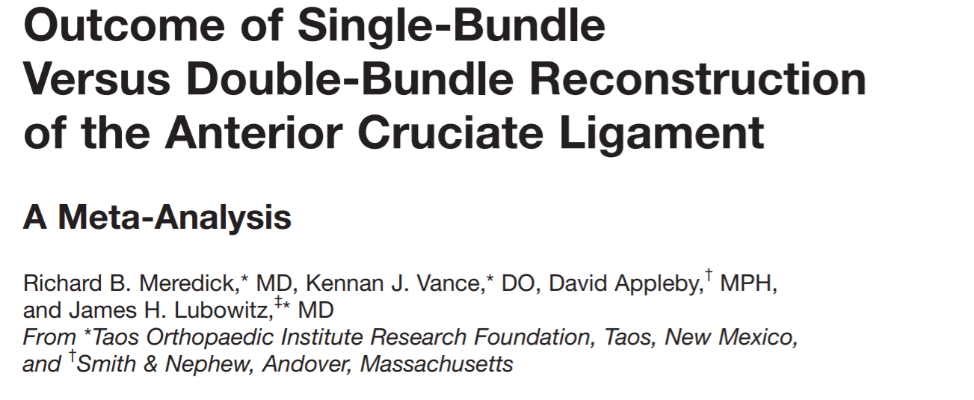
Presented by
Wendell Cole, MD

Slide 16
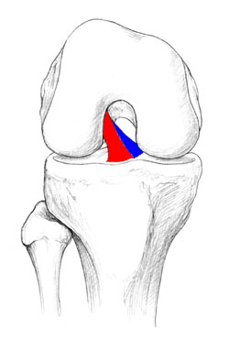
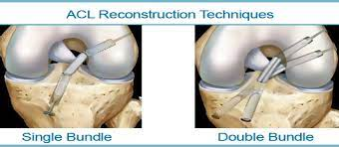
Background
2 Bundles of ACL- AM + PL
Hypothesis- failure after single bundle due to minimal IR + valgus control
Notes:
failures after ACL reconstruction occur because single-bundle ACL reconstruction is insufficient to control combined internal and valgus torques applied to the knee

Slide 17
Purpose
Meta analysis to compare single v double bundle ACLR outcomes

Slide 18
Methods
Primarily analyzed outcomes from Level 1 RCT
Secondarily analyzed outcomes of Level 1-3 studies
Searched MEDLINE and EMBASE databases + hand searched journals
Terms- ACL, anterior cruciate ligament, and double bundle.
Included study, including level of evidence, number of patients, patient demographics, type of surgical intervention, time of follow-up, and preoperative and postoperative evaluation results
Excluded Level IV & V

Slide 19
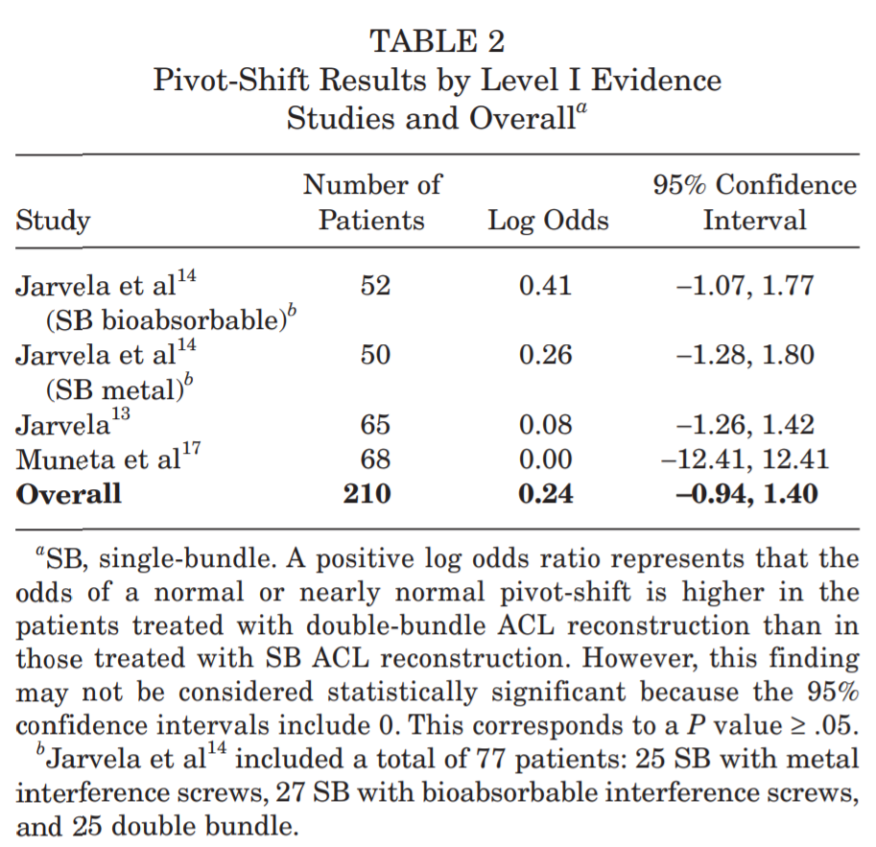
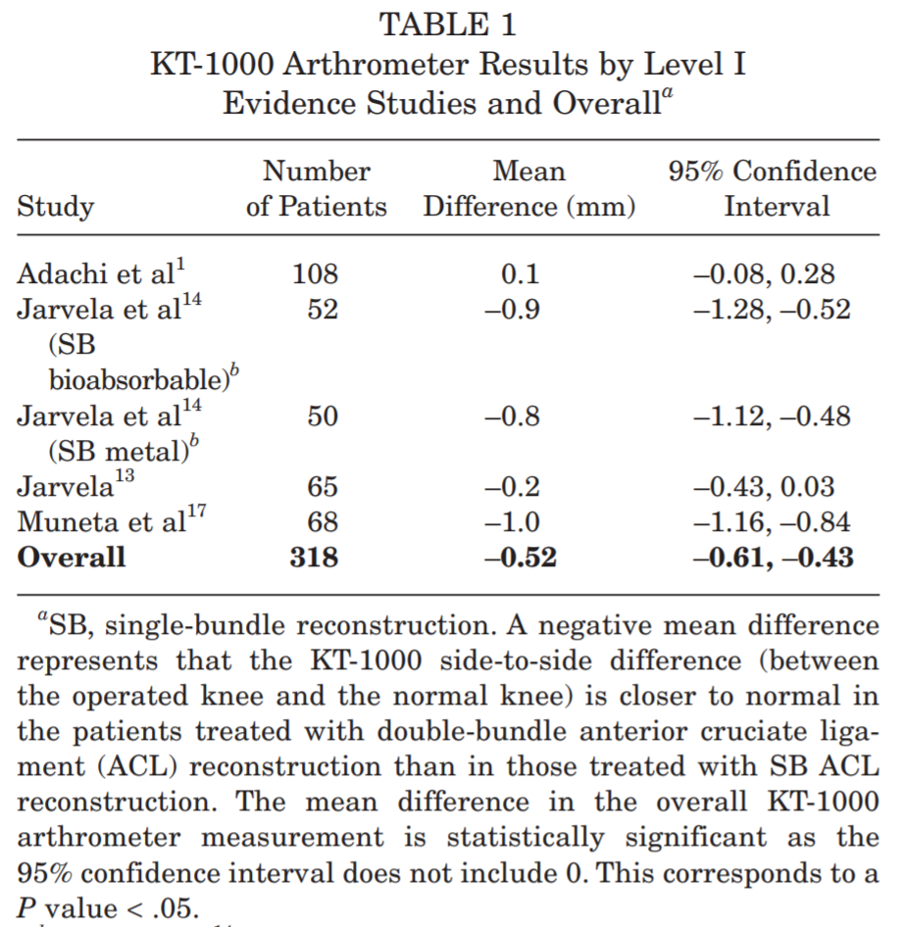
Results
9 studies included, 4 RCTs
Notes:
Main outcomes- KT 1000 and Pivot shift. Clinicaly significant KT 1000. not pivot shift
Similar results with the secondary analysis- 1000 arthrometer side-to-side difference (between the operated knee and the normal knee, in millimeters) is 0.6 mm closer to normal in the patients treated with double-bundle ACL reconstruction than in those treated with singlebundle ACL reconstruction. Statistically significant

Slide 20
Conclusion
No clinically significant difference (though KT-1000 statistically significant)
No statistaclly significant difference in regards to PS test in SB v DB
Limitations: Reporting & performance bias
Future:
Adhere to CONSORT
Use standardized outcome measures
Agreement on standardized outcomes
>better quality studies
Notes:
reporting bias due to the heterogeneity of outcome measures reported in the studies included
Consolidated Standards of Reporting Trials (CONSORT) and attempt to adhere to these criteria.7,8 This will result in improved methodologic quality of studies comparing single-bundle versus double-bundle ACL reconstruction in the future

Slide 21
A 10-Year Comparison of Anterior Cruciate Ligament Reconstructions with Hamstring Tendon and Patellar Tendon Autograft
A Controlled Prospective Trial
Leo A. Pinczewski, FRACS, Jeffry Lyman, MD, Lucy J. Salmon, PhD, Vivianne J. Russell, BSc (Biomed), Justin Roe, FRACS, and James Linklaster, FRANZCR
From North Sydney Orthopaedic and Sports Medicine Centre, Sydney, Australia, and Castlereagh Imaging, Sydney Australia
Presented by: Tucker Peabody, DO

Slide 22
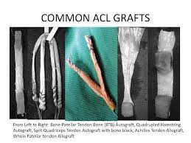
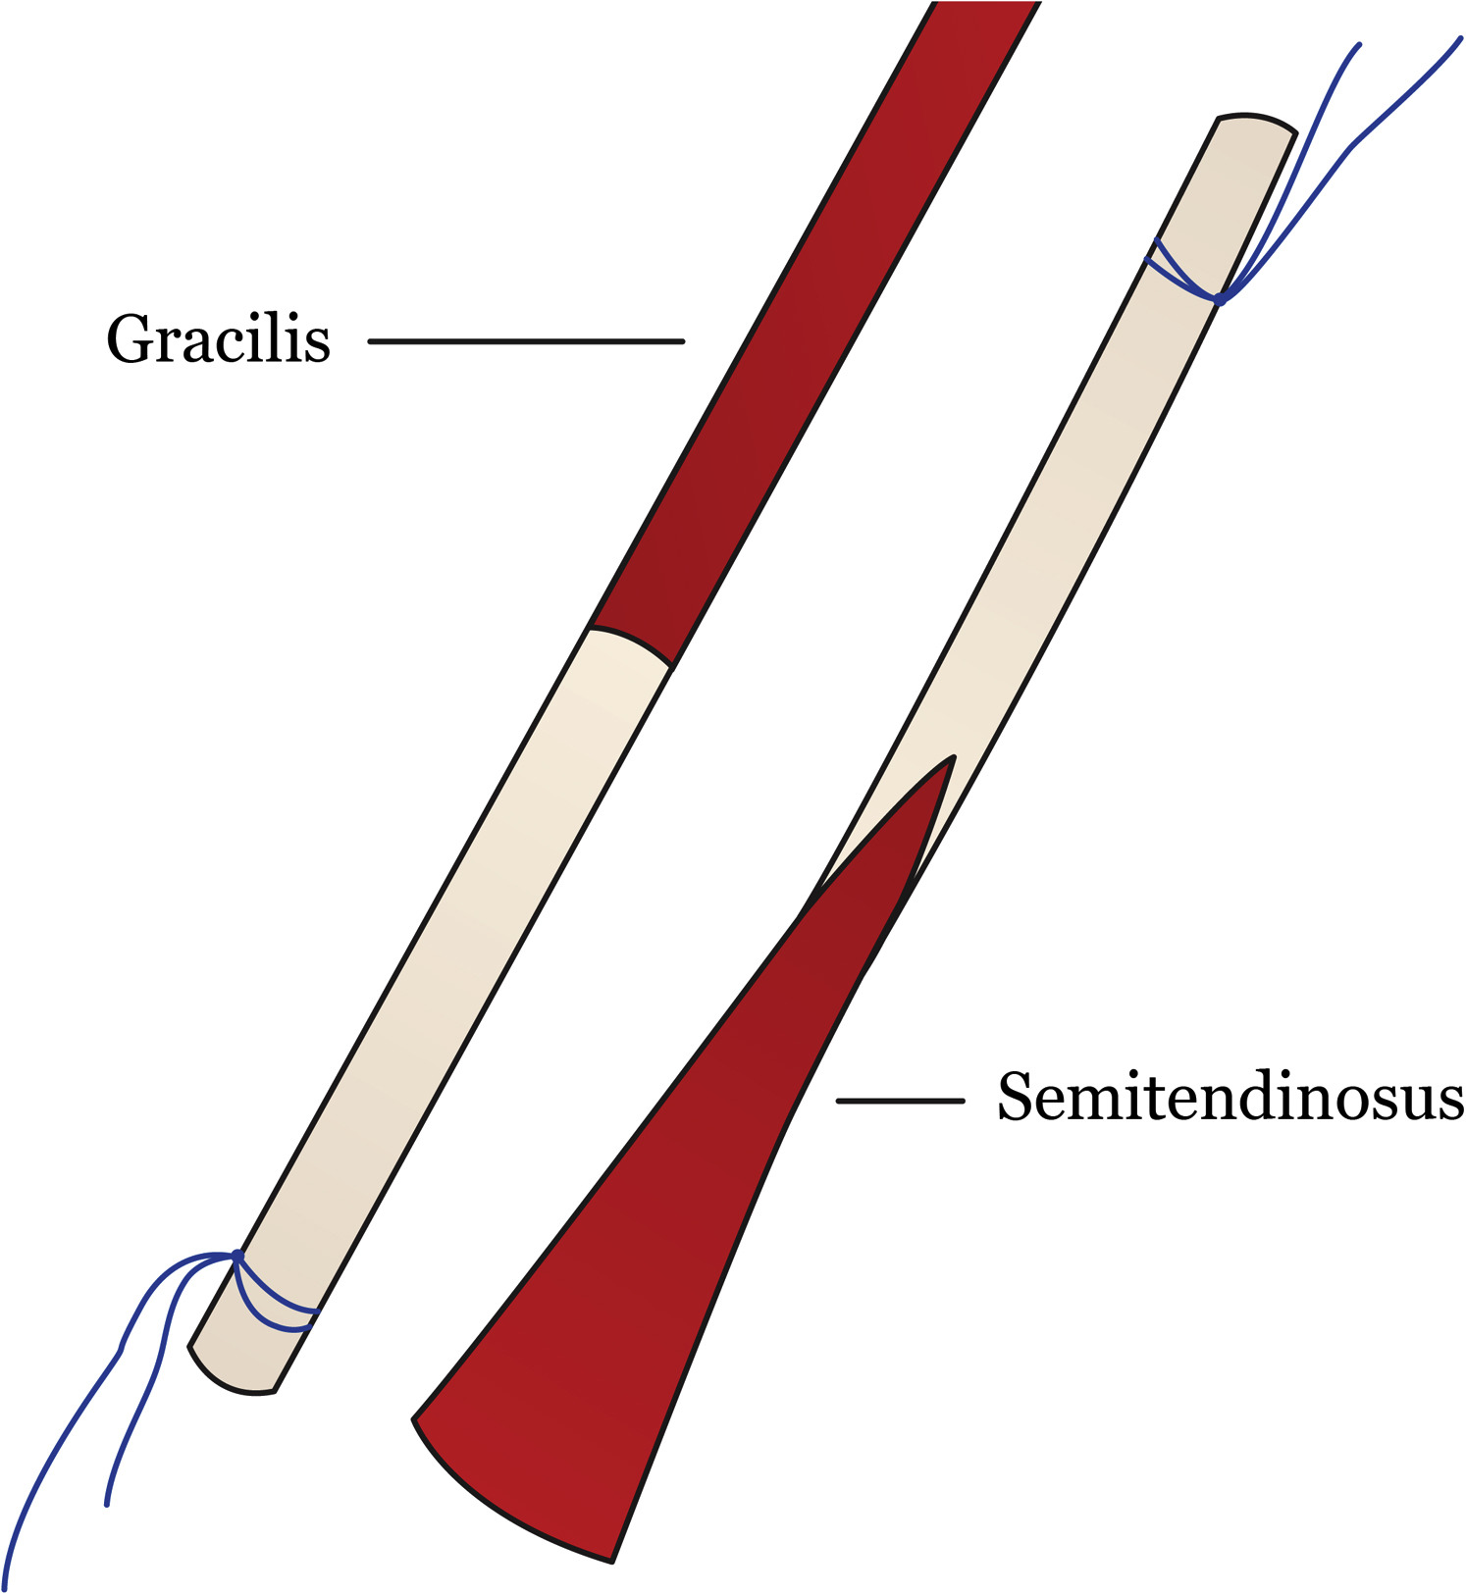
Background
Bone Patellar Tendon Bone Autograft
Considered “gold standard”
Utilization of bone plugs to incorporate faster incorporation of graft
Increased risk of anterior knee pain and patella fracture
Hamstring Autograft
Typically semitendinosus and gracilis autograft
Higher load to failure compared to patellar tendon
Smaller incision and less anterior knee pain
Hamstring weakness

Slide 23
Purpose
Prospective cohort study to assess and compare the long term (10 year) outcomes for Hamstring Tendon and Patellar Tendon autograft ACL reconstruction

Slide 24
Methods
180 ACL-deficient knees (90 HT and 90 BTB)
All surgeries performed by one surgeon
All procedures observed in prospective fashion for 10 years
Subjective, objective, and radiographic evaluation
2,5,7,10-year intervals
Subjective measurements included: IKDC, symptoms with activity, Lysholm Knee Score, activity level, harvest-site symptoms, kneeling pain
Objective measurements: Clinical ligament evaluation, ROM, single-leg hop, radiographic assessment

Slide 25
Results
Significantly higher incidence of radiographic evidence of osteoarthritic changes in PT reconstructed knees
Kneeling pain significantly increased in PT-reconstructed knees
Downward trend in IKDC (International Knee Documentation Committee) in the PT group compared to HT
69% HT group met “ideal outcome” compared to 47% PT group (P=.03)
Ideal= IKDC grade A or B and radiographic grade A

Slide 26
Conclusion
Both HT and PT autograft ACL reconstructions have excellent 10-year outcomes subjectively and objectively
HT autograft showed more favorable outcomes compared to PT reconstruction

Slide 27
Presented by Tariq Said, BA

Slide 28
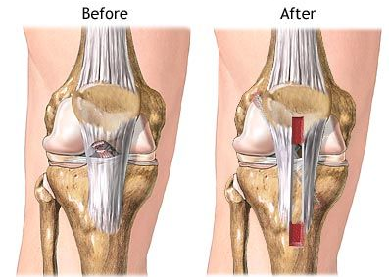
Background
Acutely torn ACL’s are commonly treated surgically
Surgical reconstruction is commonly regarded as critical for good outcomes
However, there is a lack of high-quality RCT’s comparing ACL reconstruction with other treatments
Notes:
ACL – anterior cruciate ligament RCT – randomized controlled trials; >200K ACL recons performed yearly in US with estimated cost of $3 billion annually

Slide 29
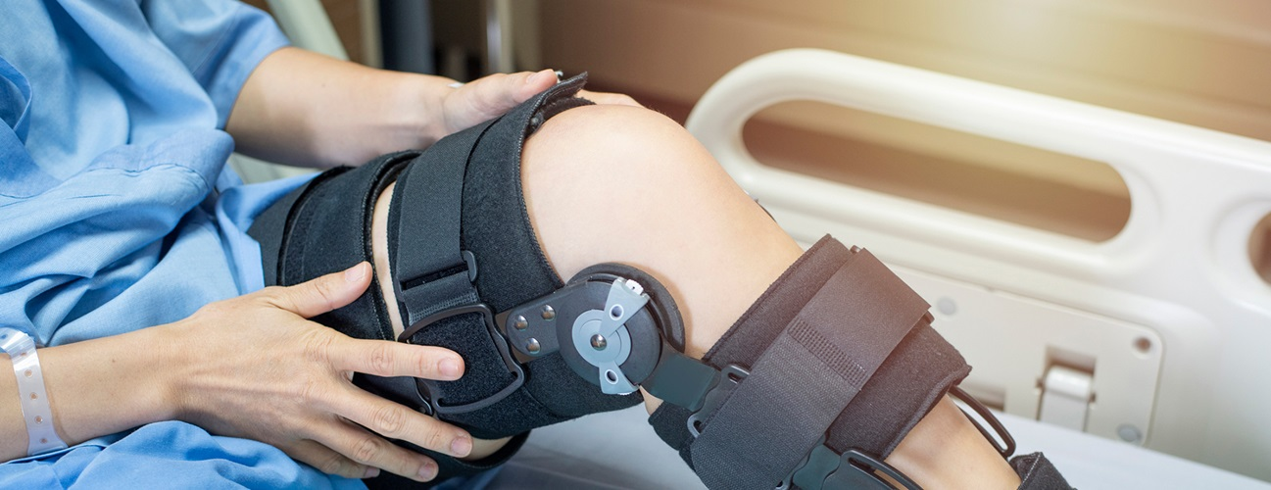
Purpose
To compare treatment options for torn ACL
Structured Rehabilitation with early reconstructive surgery
Versus
Structured Rehabilitation with optional delayed reconstructive Surgery

Slide 30
Methods
Subjects ages 18 – 35 years presenting to ED with knee trauma were screened for eligibility
Eligibility dictated rotational trauma to previously uninjured knee within last 4 weeks, ACL insufficiency on clinical exam, and score of 5 – 9 of TAS prior to injury
Exclusions included total collateral ligament rupture and full thickness cartilage lesion on MRI
Subjects were randomized to different surgical timeline groups by computer generated numbers and all subjects followed rehab protocol consistent with literature initiated before/at time of randomization
Meniscal surgery was carried out as needed, however any subjects with meniscocapsular separations >10 mm were excluded from study due to changes in rehab regimen
Notes:
TAS – Tegner activity scale (1-10 scale determining level of participation in athletic activities, 5 = recreational sport and 9 = competitive sports on nonprofessional scale)

Slide 31
Methods (cont.)
Early ACL reconstruction occurred within 10 weeks by one of four senior knee surgeons with choice of procedure according to preference (patella-tendon vs hamstring tendon)
Optional Delayed ACL reconstruction subjects underwent the same procedures IF they desired and continued to have symptomatic knee instability due to ACL insufficiency and positive pivot shift
Primary outcome: average score of KOOS from baseline to 2 years excluding ADL subscale
Secondary outcomes included other scoring results (all five KOOS, SF-36, TAS, and more)
Exploratory outcomes included knee stability, pivot shift, and KT1000
Notes:
Both tendon choices have resulted in similar outcomes in randomized trials
KOOS: Knee injury and osteoarthritis outcome score (0 to 100 (best))
SF-36: medical outcomes study 36 item short-form health survey (0 to 100 (best))
TAS: activity scale
2y outcomes: (
(KOOS4 score per visit × time to follow-up [in days]) from baseline to 2 years, and the percentage of subjects with a KOOS quality-of-life score below 44 (a prespecified cutoff value consistent with a report of more than moderately decreased knee-related quality of life) between 6 months and 2 years

Slide 32
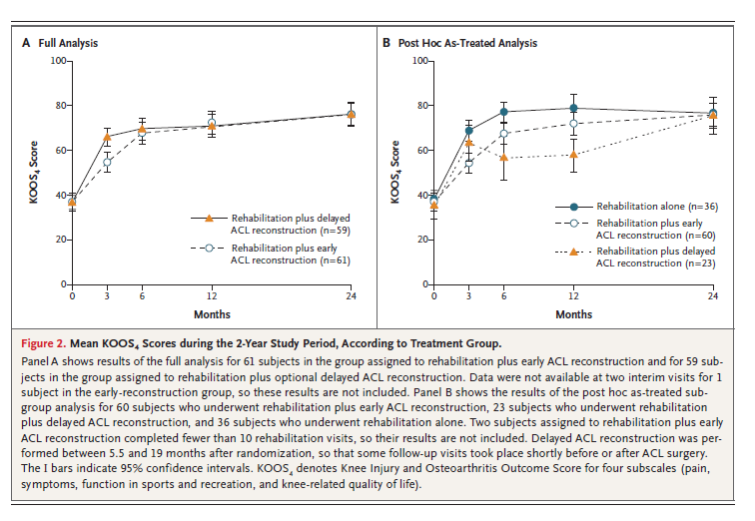
Results
62 subjects in Rehab with early ACL recon
59 subjects in rehab with optional delayed ACL recon
23 of 59 subjects underwent reconstruction about 12 months after randomization
Mean KOOS₄ score was insignificantly different from baseline to 2 years in either group (39.2 and 39.4)
absolute difference of 0.18 95% CI [-6.5 to 6.8] P=0.96

Slide 33
Conclusion
Limited by specificity of rehabilitation protocol and patient demographic
Demonstrated no better patient outcome with a structured rehabilitation and early ACL surgery vs optional, delayed reconstruction
Take Away: Greater than half of ACL reconstructions can be avoided without adversely affecting outcomes

